Slide 1

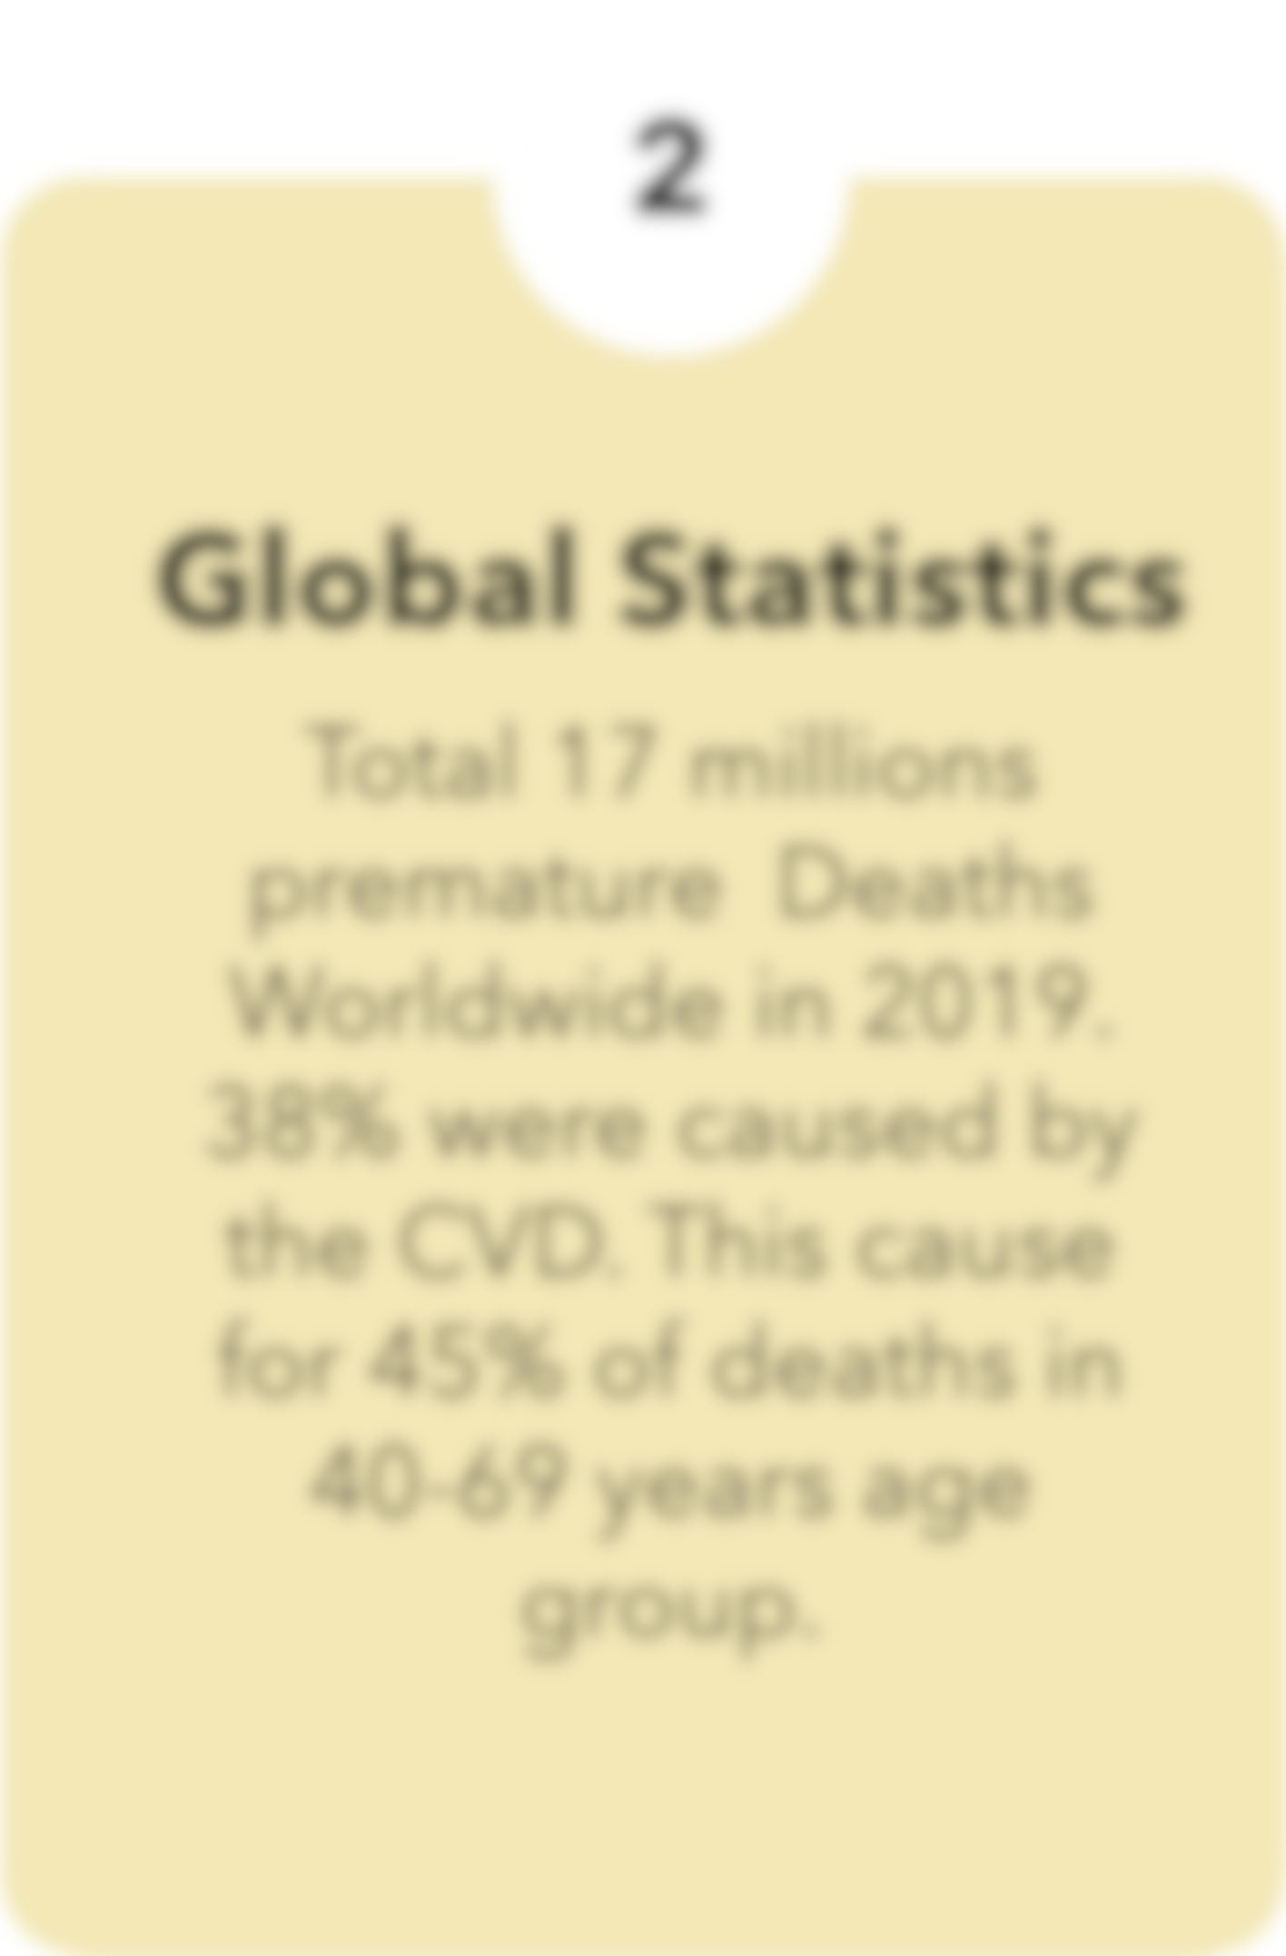
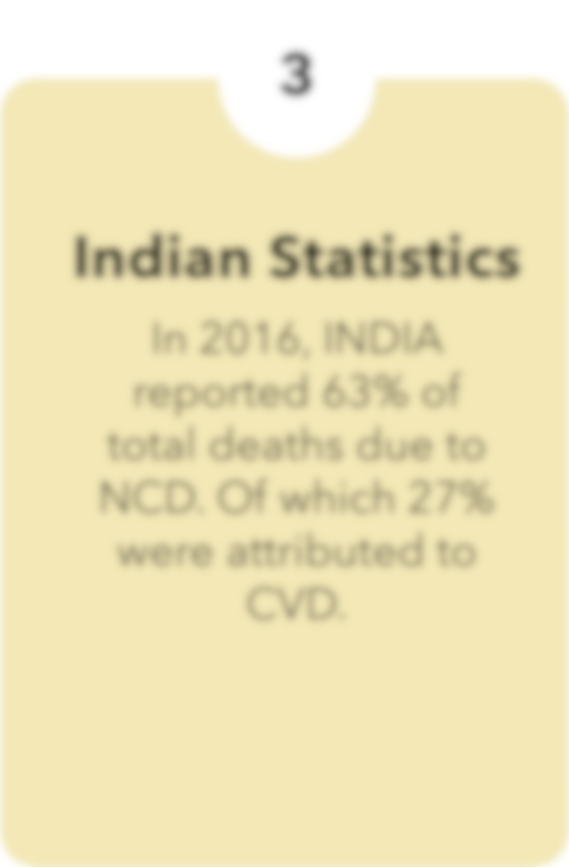


Predictive Modelling
Cardiovascular
For
Disease
Risk Assessment
Notes:
Good morning, Sir. Today, I am going to discuss my undergraduate dissertation topic, which focuses on predictive modelling for cardiovascular disease risk assessment. Before delving into the topic, let's briefly explore why I selected this particular area of study and discuss the scope and objectives of this research.
Go to Slide 2

Slide 2
Notes:
Cardiovascular disease stands as one of the most significant medical challenges globally today.
Read Slide 2

Slide 3
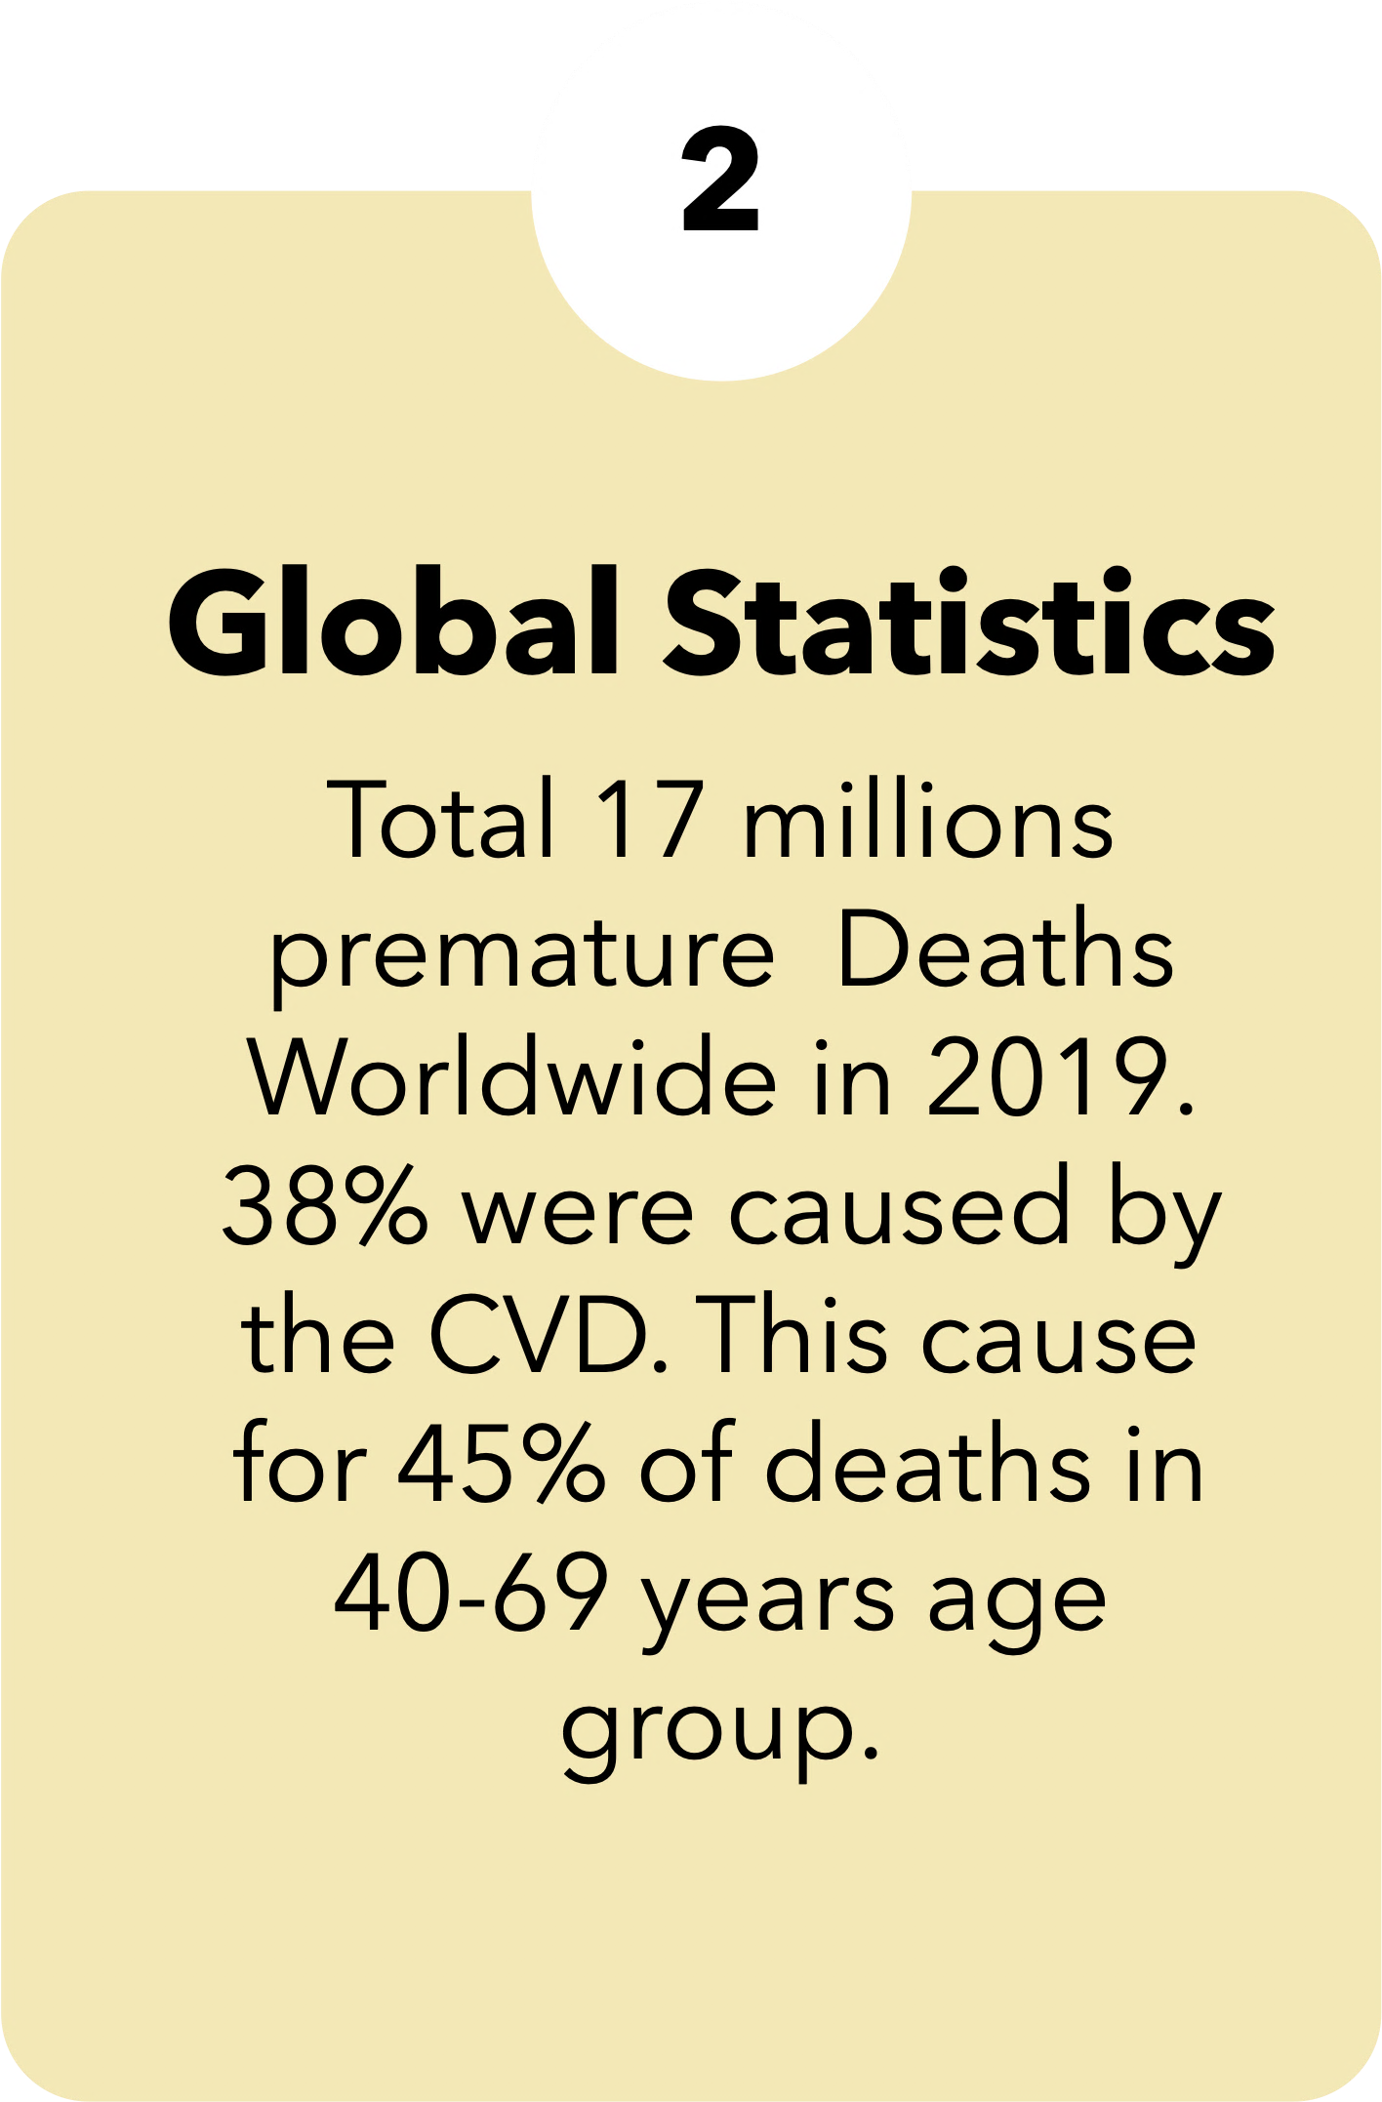
Notes:
According to the WHO official Statistics,
Read Slide 3

Slide 4
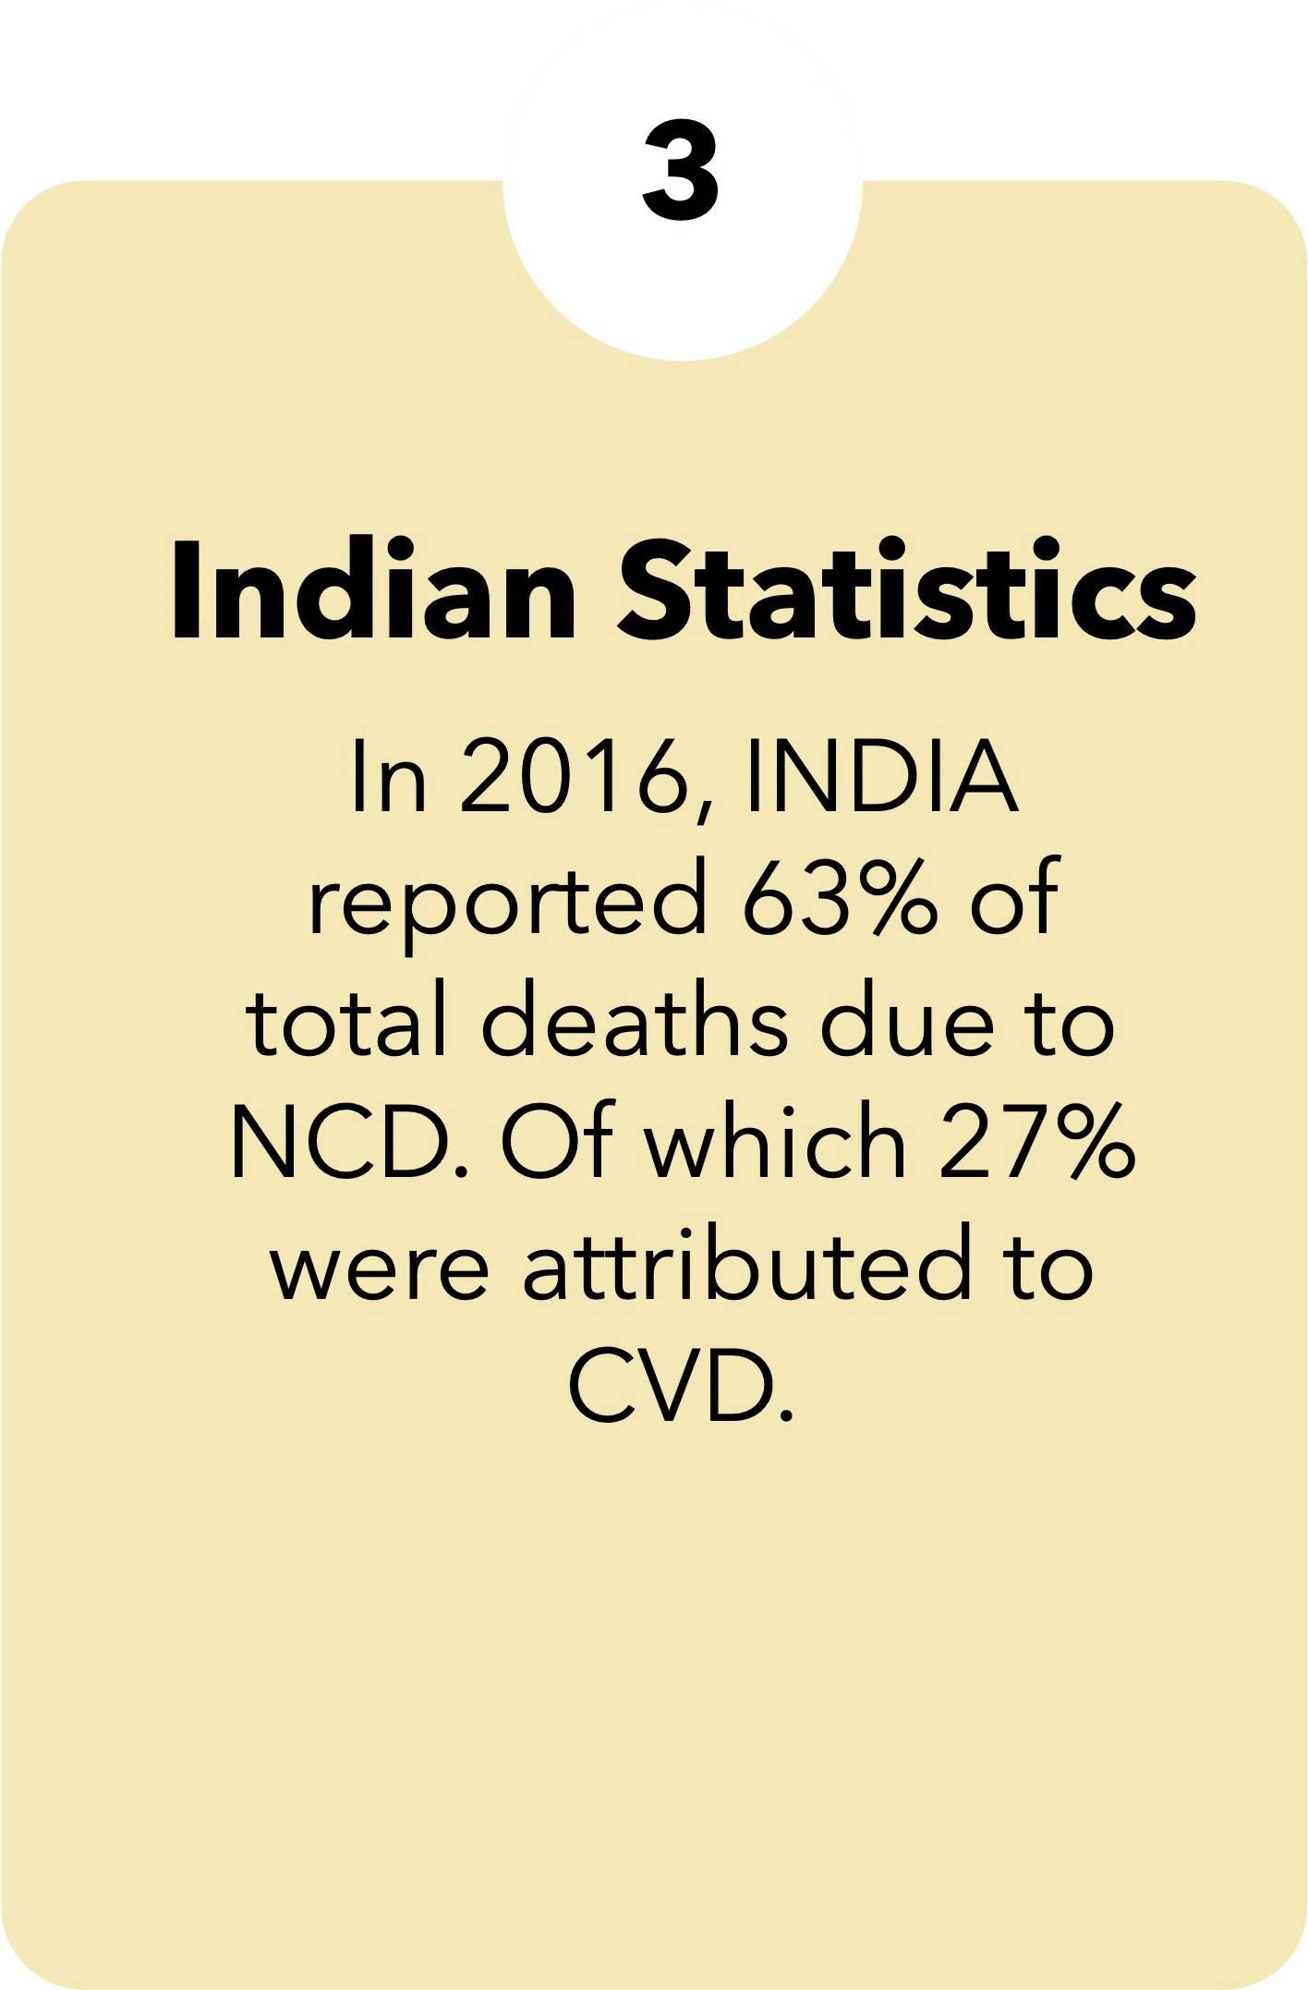
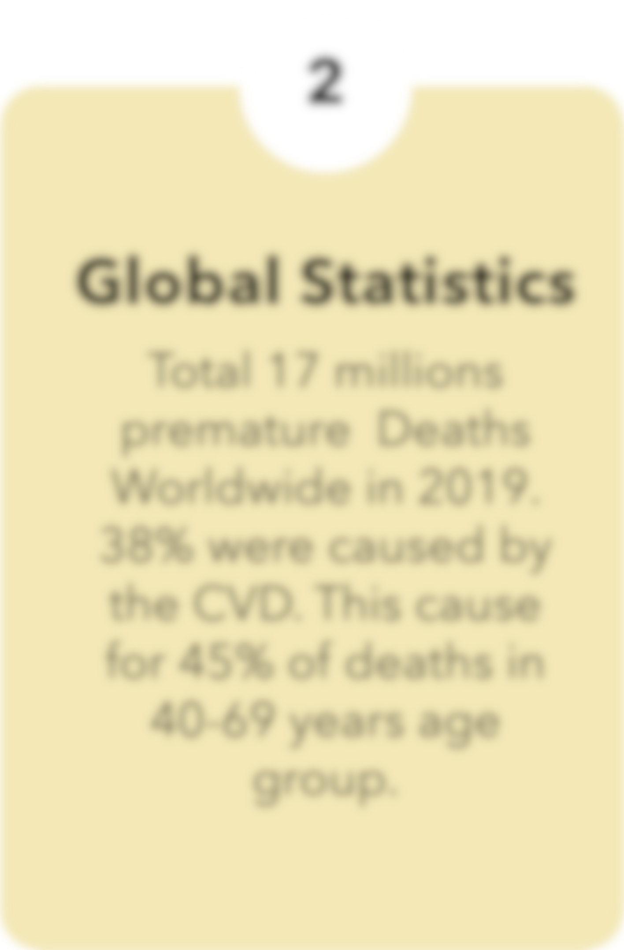
Notes:
Read Slide 4
Now let’s see some quick scopes and objectives of this study The first priority of the objective of this study
Go to Slide 5

Slide 5

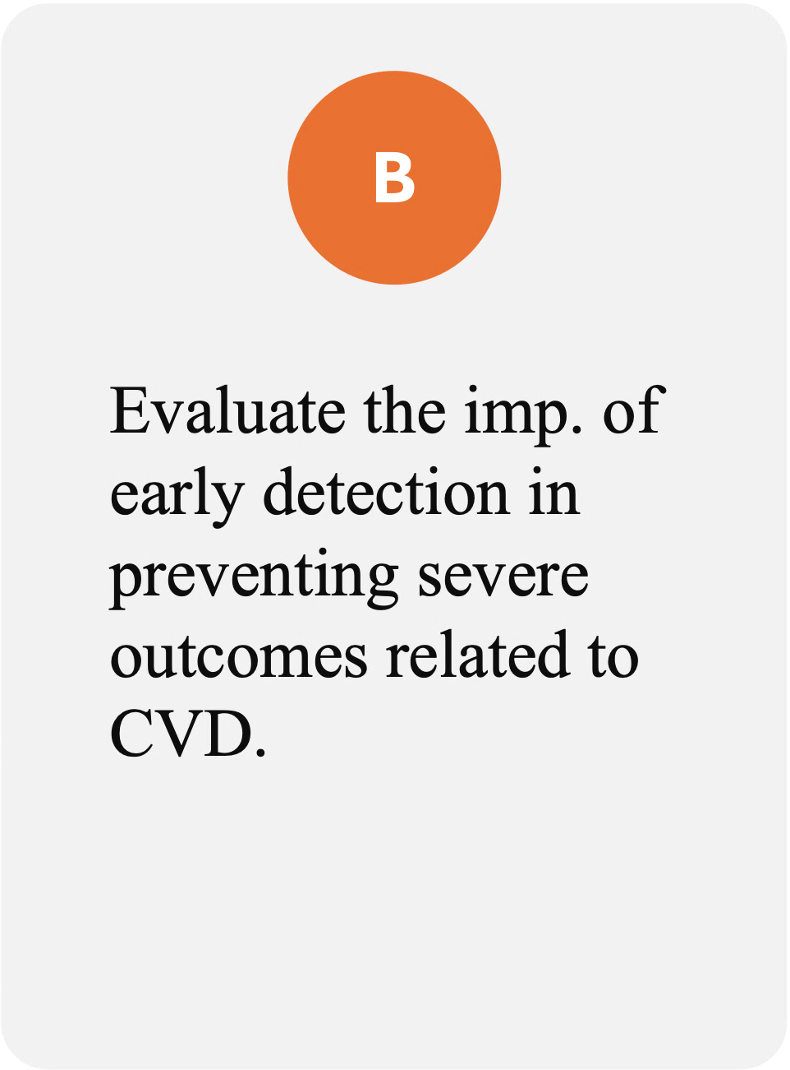
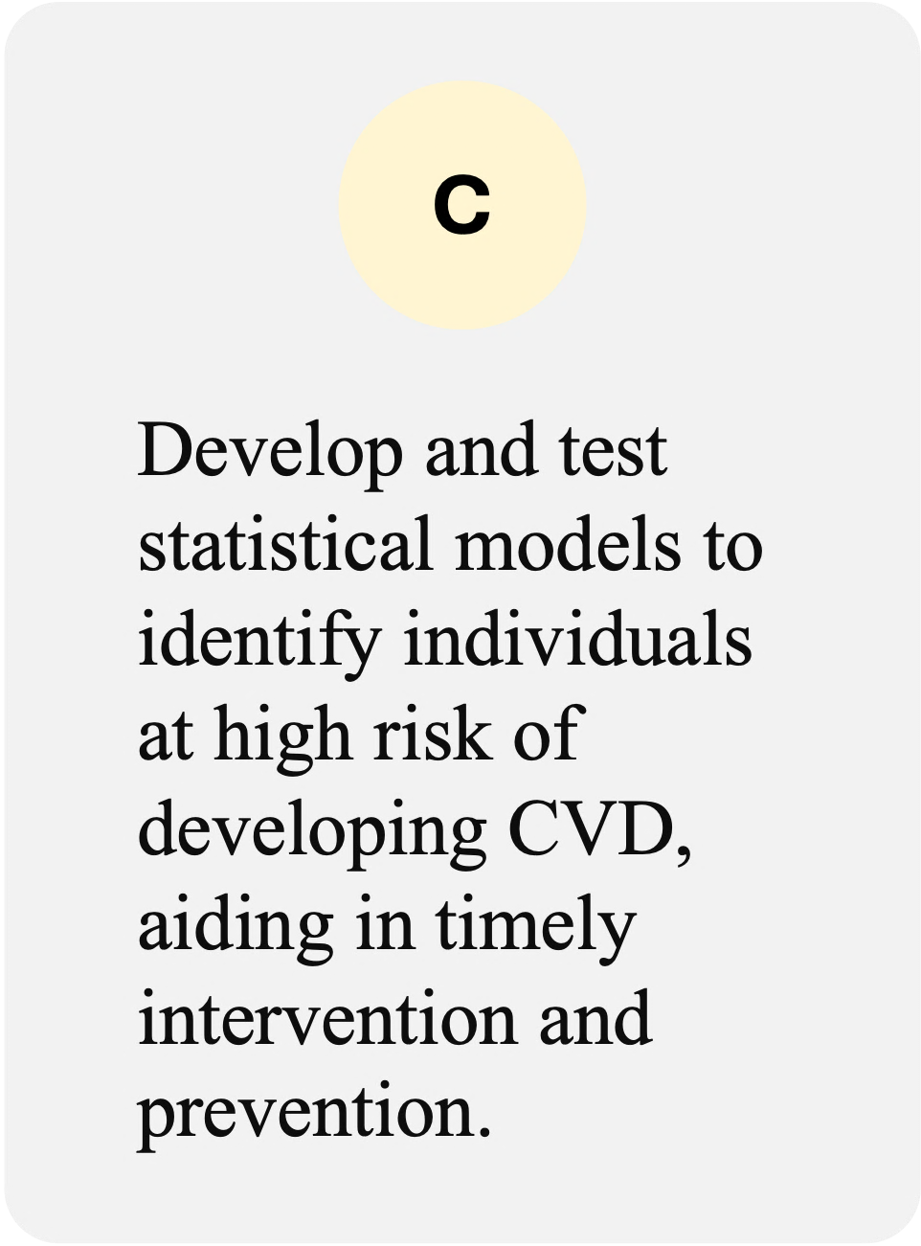

Scope and Objective
Notes:
Read Slide 5

Slide 6
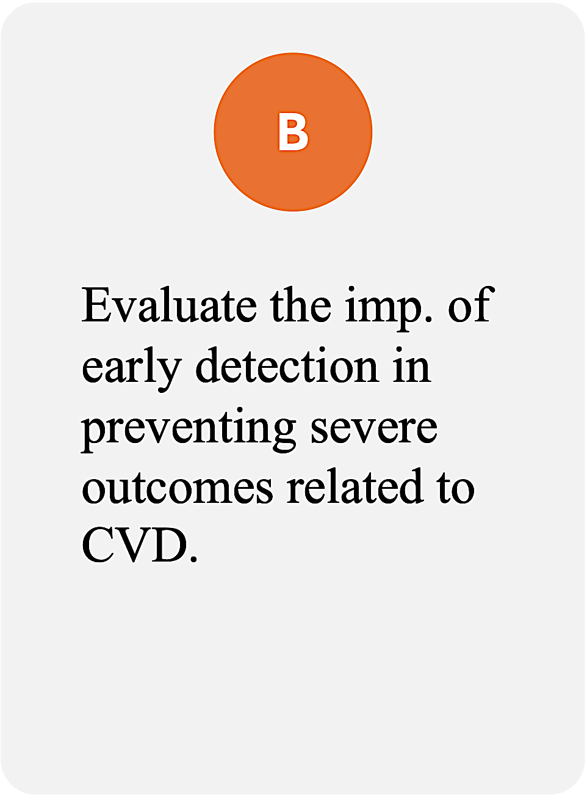


Scope and Objective
Notes:
Read Slide 6

Slide 7
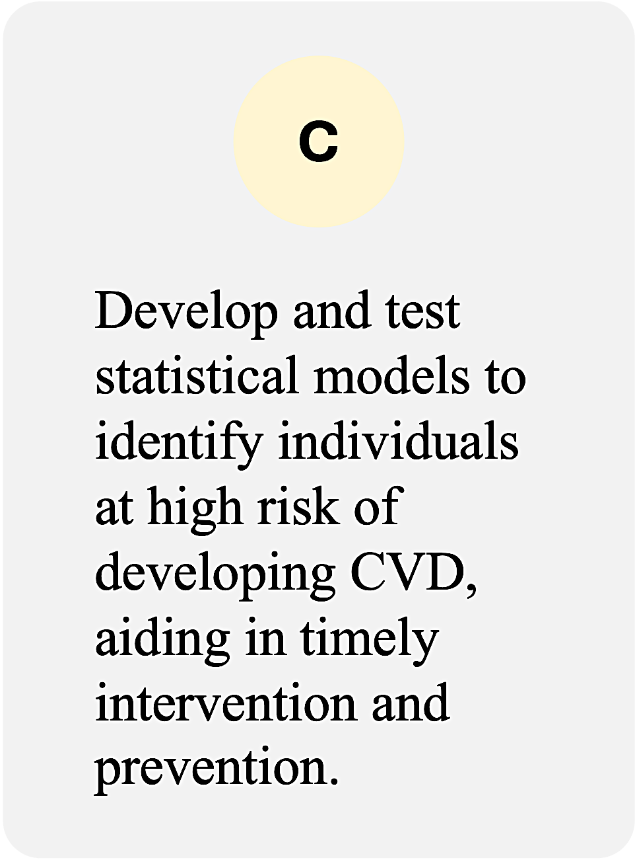
Scope and Objective
Notes:
Read Slide 7

Slide 8

Assumption
Assumption
Scope and Objective
01
03
04
Assumption
Assumption
01
02
Logistic
02
Categories should be both mutually exclusive and exhaustive, meaning that each case can only belong to one group and every case must be a member of one of the groups .
In contrast to linear regression, Logistic Regression often demands larger sample sizes due to the reliance on maximum likelihood estimation. Which is based on approximations derived from large sample theory.
Regression
Logistic Regression doesn't Presuppose any linear relationship between the predictor and the response variable.
03
The response variable should exhibit a dichotomous nature, meaning it can be categorised into two distinct groups
Assumptions
04
Notes:
Read Slide 8
Go to Slide 9

Slide 9
Assumption
Assumption
01
04
03
Assumption
Assumption
01
02
Logistic
02
In contrast to linear regression, Logistic Regression often demands larger sample sizes due to the reliance on maximum likelihood estimation. Which is based on approximations derived from large sample theory.
Categories should be both mutually exclusive and exhaustive, meaning that each case can only belong to one group and every case must be a member of one of the groups .
Regression
Logistic Regression doesn't Presuppose any linear relationship between the predictor and the response variable.
03
The response variable should exhibit a dichotomous nature, meaning it can be categorised into two distinct groups
Assumptions
04
Notes:
For all our predictive work, we will be utilizing logistic regression.
Logistic regression/Binary Regression is a critical area of research that aims to understand the factors that contribute to the development and progression of cardiovascular disease. Logistic regression can be used to analyze CVD data and identify the factors that are associated with the disease.
Before we delve into the specifics, let's outline a few assumptions inherent to logistic regression models, which are crucial for interpreting our results accurately.

Slide 10
Assumption
Assumption
01
03
04
Assumption
Assumption
01
02
02
Categories should be both mutually exclusive and exhaustive, meaning that each case can only belong to one group and every case must be a member of one of the groups .
In contrast to linear regression, Logistic Regression often demands larger sample sizes due to the reliance on maximum likelihood estimation. Which is based on approximations derived from large sample theory.
Logistic Regression
Logistic Regression doesn't Presuppose any linear relationship between the predictor and the response variable.
03
The response variable should exhibit a dichotomous nature, meaning it can be categorised into two distinct groups
04
Notes:
Read Slide 10

Slide 11
Assumption
Assumption
01
03
04
Assumption
Assumption
01
02
02
Categories should be both mutually exclusive and exhaustive, meaning that each case can only belong to one group and every case must be a member of one of the groups .
In contrast to linear regression, Logistic Regression often demands larger sample sizes due to the reliance on maximum likelihood estimation. Which is based on approximations derived from large sample theory.
Logistic Regression doesn't Presuppose any linear relationship between the predictor and the response variable.
Logistic Regression
The response variable should exhibit a dichotomous nature, meaning it can be categorised into two distinct groups
03
04
Notes:
Read Slide 11

Slide 12
Assumption
Assumption
01
03
04
Assumption
Assumption
01
02
02
Categories should be both mutually exclusive and exhaustive, meaning that each case can only belong to one group and every case must be a member of one of the groups .
In contrast to linear regression, Logistic Regression often demands larger sample sizes due to the reliance on maximum likelihood estimation. Which is based on approximations derived from large sample theory.
Logistic Regression doesn't Presuppose any linear relationship between the predictor and the response variable.
Logistic Regression
The response variable should exhibit a dichotomous nature, meaning it can be categorised into two distinct groups
03
04
Notes:
Read Slide 12

Slide 13
Assumption
Assumption
01
03
04
Assumption
Assumption
01
02
02
Categories should be both mutually exclusive and exhaustive, meaning that each case can only belong to one group and every case must be a member of one of the groups .
In contrast to linear regression, Logistic Regression often demands larger sample sizes due to the reliance on maximum likelihood estimation. Which is based on approximations derived from large sample theory.
Logistic Regression doesn't Presuppose any linear relationship between the predictor and the response variable.
Logistic Regression
The response variable should exhibit a dichotomous nature, meaning it can be categorised into two distinct groups
03
04
Notes:
Read Slide 13
Go to Slide 14

Slide 14




GETTING TO KNOW THE
DATASET
Glucose
Heart
Rate
BMI
DIAS BP
SYS BP
Diabetes
STROKE
BP
No. of
3657
Origin
Glucose
Heart
Rate
BMI
DIAS BP
Chol.
HYP
Cigs
CVD
No of Datapoints
Origin Of the Dataset
No of Datapoints
CHD - 10 Year Risk
Sex
Age
Education
Current Smoker
Cigs. Per Day
BP Meds
Prevalent Stroke
Prevalent Hypersensitivity
Diabetes
Total Cholesterol
Sys BP
Dia BP
BMI
Heart Rate
Glucose
In the Dataset, there are in total 3,657 data points available encompassing various demographic, behavioural, and medical risk factors.
This Cardiovascular Disease Dataset Dataset Was collected from the UCI Machine Learning Library
In the Dataset, there are in total 3,657 data points available encompassing various demographic, behavioural, and medical risk factors.
Binary Variables
Binary Variable indicating the presence (1) or absence(0) of CHD risk.
Categorical ( Nominal )
0 = Female , 1 = male
Continuous
Age in years
Categorical ( Nominal )
Denotes the Education Level of the individual.
1 : Pre-College Level
2 : Undergrad Level
3 : Postgrad Level
Categorical ( Nominal )
0 = Don’t Smoke , 1 = Smoke
Categorical ( Nominal )
0 = Don’t Smoke , 1 = Smoke
Categorical ( Nominal )
Specifies if the individual was using medication for blood pressure management..[ 0 = Not Diabetic , 1 = Diabetic ]
Categorical ( Nominal )
Identifies whether the patient has previously experienced a stroke. [ 0 = Haven’t , 1 = Have experienced ]
Categorical ( Nominal )
Indicates whether the patient is hypertensive [ 0 =Patient isn’t Hypersensitive,1=Patient is Hypersensitive ]
Categorical ( Nominal )
Identifies whether the patient has diabetes. [0 = Patient isn’t Diabetes , 1 = Patient is Diabetic ]
Continuous
Represents the total blood cholesterol level.
Continuous
Represents the systolic blood pressure level.
Continuous
Represents the Diastolic blood pressure level
Continuous
Represents the individual’s Body Mass Index
Continuous
Represents the heart rate treated as continuous due to the large number of possible values.
Continuous
Represents the heart rate treated as continuous due to the large number of possible values.
Notes:
The Dataset used here is collected from the UCI machine learning repository . Our study aims to analyze the trends and the risk factors for CVD based on the explanatory variables.
Let’s get to know the dataset.

Slide 15
GETTING TO KNOW THE
DATASET
Glucose
Heart
Rate
BMI
DIAS BP
SYS BP
Chol.
Diabetes
STROKE
BP
No. of
3657
Origin
Glucose
Heart
Rate
BMI
DIAS BP
HYP
Cigs
CVD
No of Datapoints
Origin Of the Dataset
No of Datapoints
CHD - 10 Year Risk
Sex
Age
Education
Current Smoker
Cigs. Per Day
BP Meds
Prevalent Stroke
Prevalent Hypersensitivity
Diabetes
Total Cholesterol
Sys BP
Dia BP
BMI
Heart Rate
Glucose
In the Dataset, there are in total 3,657 data points available encompassing various demographic, behavioural, and medical risk factors.
This Cardiovascular Disease Dataset Dataset Was collected from the UCI Machine Learning Library
In the Dataset, there are in total 3,657 data points available encompassing various demographic, behavioural, and medical risk factors.
Binary Variables
Binary Variable indicating the presence (1) or absence(0) of CHD risk.
Categorical ( Nominal )
0 = Female , 1 = male
Continuous
Age in years
Categorical ( Nominal )
Denotes the Education Level of the individual.
1 : Pre-College Level
2 : Undergrad Level
3 : Postgrad Level
Categorical ( Nominal )
0 = Don’t Smoke , 1 = Smoke
Categorical ( Nominal )
0 = Don’t Smoke , 1 = Smoke
Categorical ( Nominal )
Specifies if the individual was using medication for blood pressure management..[ 0 = Not Diabetic , 1 = Diabetic ]
Categorical ( Nominal )
Identifies whether the patient has previously experienced a stroke. [ 0 = Haven’t , 1 = Have experienced ]
Categorical ( Nominal )
Indicates whether the patient is hypertensive [ 0 =Patient isn’t Hypersensitive,1=Patient is Hypersensitive ]
Categorical ( Nominal )
Identifies whether the patient has diabetes. [0 = Patient isn’t Diabetes , 1 = Patient is Diabetic ]
Continuous
Represents the total blood cholesterol level.
Continuous
Represents the systolic blood pressure level.
Continuous
Represents the Diastolic blood pressure level
Continuous
Represents the individual’s Body Mass Index
Continuous
Represents the heart rate treated as continuous due to the large number of possible values.
Continuous
Represents the heart rate treated as continuous due to the large number of possible values.
Response Variable
Notes:
Read Slide 15

Slide 16
Response
Variable
GETTING TO KNOW THE
DATASET
Glucose
Heart
Rate
BMI
DIAS BP
SYS BP
Chol.
Diabetes
STROKE
BP
No. of
3657
Origin
Glucose
Heart
Rate
BMI
DIAS BP
HYP
Cigs
CVD
No of Datapoints
Origin Of the Dataset
No of Datapoints
CHD - 10 Year Risk
Sex
Age
Education
Current Smoker
Cigs. Per Day
BP Meds
Prevalent Stroke
Prevalent Hypersensitivity
Diabetes
Total Cholesterol
Sys BP
Dia BP
BMI
Heart Rate
Glucose
In the Dataset, there are in total 3,657 data points available encompassing various demographic, behavioural, and medical risk factors.
This Cardiovascular Disease Dataset Dataset Was collected from the UCI Machine Learning Library
In the Dataset, there are in total 3,657 data points available encompassing various demographic, behavioural, and medical risk factors.
Binary Variables
Binary Variable indicating the presence (1) or absence(0) of CHD risk.
Categorical ( Nominal )
0 = Female , 1 = male
Continuous
Age in years
Categorical ( Nominal )
Denotes the Education Level of the individual.
1 : Pre-College Level
2 : Undergrad Level
3 : Postgrad Level
Categorical ( Nominal )
0 = Don’t Smoke , 1 = Smoke
Categorical ( Nominal )
0 = Don’t Smoke , 1 = Smoke
Categorical ( Nominal )
Specifies if the individual was using medication for blood pressure management..[ 0 = Not Diabetic , 1 = Diabetic ]
Categorical ( Nominal )
Identifies whether the patient has previously experienced a stroke. [ 0 = Haven’t , 1 = Have experienced ]
Categorical ( Nominal )
Indicates whether the patient is hypertensive [ 0 =Patient isn’t Hypersensitive,1=Patient is Hypersensitive ]
Categorical ( Nominal )
Identifies whether the patient has diabetes. [0 = Patient isn’t Diabetes , 1 = Patient is Diabetic ]
Continuous
Represents the total blood cholesterol level.
Continuous
Represents the systolic blood pressure level.
Continuous
Represents the Diastolic blood pressure level
Continuous
Represents the individual’s Body Mass Index
Continuous
Represents the heart rate treated as continuous due to the large number of possible values.
Continuous
Represents the heart rate treated as continuous due to the large number of possible values.
Notes:
Read Slide 16

Slide 17
Demographic
Factor
GETTING TO KNOW THE
DATASET
Glucose
Heart
Rate
BMI
DIAS BP
SYS BP
Chol.
Diabetes
STROKE
BP
No. of
3657
Origin
Glucose
Heart
Rate
BMI
DIAS BP
HYP
Cigs
CVD
No of Datapoints
Origin Of the Dataset
No of Datapoints
CHD - 10 Year Risk
Sex
Age
Education
Current Smoker
Cigs. Per Day
BP Meds
Prevalent Stroke
Prevalent Hypersensitivity
Diabetes
Total Cholesterol
Sys BP
Dia BP
BMI
Heart Rate
Glucose
In the Dataset, there are in total 3,657 data points available encompassing various demographic, behavioural, and medical risk factors.
This Cardiovascular Disease Dataset Dataset Was collected from the UCI Machine Learning Library
In the Dataset, there are in total 3,657 data points available encompassing various demographic, behavioural, and medical risk factors.
Binary Variables
Binary Variable indicating the presence (1) or absence(0) of CHD risk.
Categorical ( Nominal )
0 = Female , 1 = male
Continuous
Age in years
Categorical ( Nominal )
Denotes the Education Level of the individual.
1 : Pre-College Level
2 : Undergrad Level
3 : Postgrad Level
Categorical ( Nominal )
0 = Don’t Smoke , 1 = Smoke
Categorical ( Nominal )
0 = Don’t Smoke , 1 = Smoke
Categorical ( Nominal )
Specifies if the individual was using medication for blood pressure management..[ 0 = Not Diabetic , 1 = Diabetic ]
Categorical ( Nominal )
Identifies whether the patient has previously experienced a stroke. [ 0 = Haven’t , 1 = Have experienced ]
Categorical ( Nominal )
Indicates whether the patient is hypertensive [ 0 =Patient isn’t Hypersensitive,1=Patient is Hypersensitive ]
Categorical ( Nominal )
Identifies whether the patient has diabetes. [0 = Patient isn’t Diabetes , 1 = Patient is Diabetic ]
Continuous
Represents the total blood cholesterol level.
Continuous
Represents the systolic blood pressure level.
Continuous
Represents the Diastolic blood pressure level
Continuous
Represents the individual’s Body Mass Index
Continuous
Represents the heart rate treated as continuous due to the large number of possible values.
Continuous
Represents the heart rate treated as continuous due to the large number of possible values.
Notes:
Read Slide 17

Slide 18
Demographic
Factor
GETTING TO KNOW THE
DATASET
Glucose
Heart
Rate
BMI
DIAS BP
SYS BP
STROKE
BP
No. of
3657
Origin
Glucose
Heart
Rate
BMI
DIAS BP
Chol.
Diabetes
HYP
Cigs
CVD
No of Datapoints
Origin Of the Dataset
No of Datapoints
CHD - 10 Year Risk
Sex
Age
Education
Current Smoker
Cigs. Per Day
BP Meds
Prevalent Stroke
Prevalent Hypersensitivity
Diabetes
Total Cholesterol
Sys BP
Dia BP
BMI
Heart Rate
Glucose
In the Dataset, there are in total 3,657 data points available encompassing various demographic, behavioural, and medical risk factors.
This Cardiovascular Disease Dataset Dataset Was collected from the UCI Machine Learning Library
In the Dataset, there are in total 3,657 data points available encompassing various demographic, behavioural, and medical risk factors.
Binary Variables
Binary Variable indicating the presence (1) or absence(0) of CHD risk.
Categorical ( Nominal )
0 = Female , 1 = male
Continuous
Age in years
Categorical ( Nominal )
Denotes the Education Level of the individual.
1 : Pre-College Level
2 : Undergrad Level
3 : Postgrad Level
Categorical ( Nominal )
0 = Don’t Smoke , 1 = Smoke
Categorical ( Nominal )
0 = Don’t Smoke , 1 = Smoke
Categorical ( Nominal )
Specifies if the individual was using medication for blood pressure management..[ 0 = Not Diabetic , 1 = Diabetic ]
Categorical ( Nominal )
Identifies whether the patient has previously experienced a stroke. [ 0 = Haven’t , 1 = Have experienced ]
Categorical ( Nominal )
Indicates whether the patient is hypertensive [ 0 =Patient isn’t Hypersensitive,1=Patient is Hypersensitive ]
Categorical ( Nominal )
Identifies whether the patient has diabetes. [0 = Patient isn’t Diabetes , 1 = Patient is Diabetic ]
Continuous
Represents the total blood cholesterol level.
Continuous
Represents the systolic blood pressure level.
Continuous
Represents the Diastolic blood pressure level
Continuous
Represents the individual’s Body Mass Index
Continuous
Represents the heart rate treated as continuous due to the large number of possible values.
Continuous
Represents the heart rate treated as continuous due to the large number of possible values.
Notes:
Read Slide 18

Slide 19
Demographic
Factor
GETTING TO KNOW THE
DATASET
Glucose
Heart
Rate
BMI
DIAS BP
SYS BP
Chol.
Diabetes
HYP
STROKE
BP
No. of
CVD
No
Origin
Glucose
Heart
Rate
BMI
DIAS BP
Cigs
No of Datapoints
Origin Of the Dataset
No of Datapoints
CHD - 10 Year Risk
Sex
Age
Education
Current Smoker
Cigs. Per Day
BP Meds
Prevalent Stroke
Prevalent Hypersensitivity
Diabetes
Total Cholesterol
Sys BP
Dia BP
BMI
Heart Rate
Glucose
In the Dataset, there are in total 3,657 data points available encompassing various demographic, behavioural, and medical risk factors.
This Cardiovascular Disease Dataset Dataset Was collected from the UCI Machine Learning Library
In the Dataset, there are in total 3,657 data points available encompassing various demographic, behavioural, and medical risk factors.
Binary Variables
Binary Variable indicating the presence (1) or absence(0) of CHD risk.
Categorical ( Nominal )
0 = Female , 1 = male
Continuous
Age in years
Categorical ( Nominal )
Denotes the Education Level of the individual.
1 : Pre-College Level
2 : Undergrad Level
3 : Postgrad Level
Categorical ( Nominal )
0 = Don’t Smoke , 1 = Smoke
Categorical ( Nominal )
0 = Don’t Smoke , 1 = Smoke
Categorical ( Nominal )
Specifies if the individual was using medication for blood pressure management..[ 0 = Not Diabetic , 1 = Diabetic ]
Categorical ( Nominal )
Identifies whether the patient has previously experienced a stroke. [ 0 = Haven’t , 1 = Have experienced ]
Categorical ( Nominal )
Indicates whether the patient is hypertensive [ 0 =Patient isn’t Hypersensitive,1=Patient is Hypersensitive ]
Categorical ( Nominal )
Identifies whether the patient has diabetes. [0 = Patient isn’t Diabetes , 1 = Patient is Diabetic ]
Continuous
Represents the total blood cholesterol level.
Continuous
Represents the systolic blood pressure level.
Continuous
Represents the Diastolic blood pressure level
Continuous
Represents the individual’s Body Mass Index
Continuous
Represents the heart rate treated as continuous due to the large number of possible values.
Continuous
Represents the heart rate treated as continuous due to the large number of possible values.
Notes:
Read Slide 19

Slide 20
Behavioral
Factor
GETTING TO KNOW THE
DATASET
Glucose
Heart
Rate
BMI
DIAS BP
SYS BP
Chol.
Diabetes
HYP
STROKE
BP
No. of
CVD
No
Origin
Glucose
Heart
Rate
BMI
DIAS BP
Cigs
No of Datapoints
Origin Of the Dataset
No of Datapoints
CHD - 10 Year Risk
Sex
Age
Education
Current Smoker
Cigs. Per Day
BP Meds
Prevalent Stroke
Prevalent Hypersensitivity
Diabetes
Total Cholesterol
Sys BP
Dia BP
BMI
Heart Rate
Glucose
In the Dataset, there are in total 3,657 data points available encompassing various demographic, behavioural, and medical risk factors.
This Cardiovascular Disease Dataset Dataset Was collected from the UCI Machine Learning Library
In the Dataset, there are in total 3,657 data points available encompassing various demographic, behavioural, and medical risk factors.
Binary Variables
Binary Variable indicating the presence (1) or absence(0) of CHD risk.
Categorical ( Nominal )
0 = Female , 1 = male
Continuous
Age in years
Categorical ( Nominal )
Denotes the Education Level of the individual.
1 : Pre-College Level
2 : Undergrad Level
3 : Postgrad Level
Categorical ( Nominal )
0 = Don’t Smoke , 1 = Smoke
Categorical ( Nominal )
0 = Don’t Smoke , 1 = Smoke
Categorical ( Nominal )
Specifies if the individual was using medication for blood pressure management..[ 0 = Not Diabetic , 1 = Diabetic ]
Categorical ( Nominal )
Identifies whether the patient has previously experienced a stroke. [ 0 = Haven’t , 1 = Have experienced ]
Categorical ( Nominal )
Indicates whether the patient is hypertensive [ 0 =Patient isn’t Hypersensitive,1=Patient is Hypersensitive ]
Categorical ( Nominal )
Identifies whether the patient has diabetes. [0 = Patient isn’t Diabetes , 1 = Patient is Diabetic ]
Continuous
Represents the total blood cholesterol level.
Continuous
Represents the systolic blood pressure level.
Continuous
Represents the Diastolic blood pressure level
Continuous
Represents the individual’s Body Mass Index
Continuous
Represents the heart rate treated as continuous due to the large number of possible values.
Continuous
Represents the heart rate treated as continuous due to the large number of possible values.
Notes:
Read Slide 20

Slide 21
Behavioral
Factor
GETTING TO KNOW THE
DATASET
Glucose
Heart
Rate
BMI
DIAS BP
SYS BP
Chol.
Diabetes
HYP
STROKE
BP
No. of
CVD
No
Origin
Glucose
Heart
Rate
BMI
DIAS BP
Cigs
No of Datapoints
Origin Of the Dataset
No of Datapoints
CHD - 10 Year Risk
Sex
Age
Education
Current Smoker
Cigs. Per Day
BP Meds
Prevalent Stroke
Prevalent Hypersensitivity
Diabetes
Total Cholesterol
Sys BP
Dia BP
BMI
Heart Rate
Glucose
In the Dataset, there are in total 3,657 data points available encompassing various demographic, behavioural, and medical risk factors.
This Cardiovascular Disease Dataset Dataset Was collected from the UCI Machine Learning Library
In the Dataset, there are in total 3,657 data points available encompassing various demographic, behavioural, and medical risk factors.
Binary Variables
Binary Variable indicating the presence (1) or absence(0) of CHD risk.
Categorical ( Nominal )
0 = Female , 1 = male
Continuous
Age in years
Categorical ( Nominal )
Denotes the Education Level of the individual.
1 : Pre-College Level
2 : Undergrad Level
3 : Postgrad Level
Categorical ( Nominal )
0 = Don’t Smoke , 1 = Smoke
Categorical ( Nominal )
0 = Don’t Smoke , 1 = Smoke
Categorical ( Nominal )
Specifies if the individual was using medication for blood pressure management..[ 0 = Not Diabetic , 1 = Diabetic ]
Categorical ( Nominal )
Identifies whether the patient has previously experienced a stroke. [ 0 = Haven’t , 1 = Have experienced ]
Categorical ( Nominal )
Indicates whether the patient is hypertensive [ 0 =Patient isn’t Hypersensitive,1=Patient is Hypersensitive ]
Categorical ( Nominal )
Identifies whether the patient has diabetes. [0 = Patient isn’t Diabetes , 1 = Patient is Diabetic ]
Continuous
Represents the total blood cholesterol level.
Continuous
Represents the systolic blood pressure level.
Continuous
Represents the Diastolic blood pressure level
Continuous
Represents the individual’s Body Mass Index
Continuous
Represents the heart rate treated as continuous due to the large number of possible values.
Continuous
Represents the heart rate treated as continuous due to the large number of possible values.
Notes:
Read Slide 21

Slide 22
Medical
History
GETTING TO KNOW THE
DATASET
Glucose
Heart
Rate
BMI
DIAS BP
SYS BP
Chol.
Diabetes
HYP
STROKE
BP
No. of
CVD
No
Origin
Glucose
Heart
Rate
BMI
DIAS BP
Cigs
No of Datapoints
Origin Of the Dataset
No of Datapoints
CHD - 10 Year Risk
Sex
Age
Education
Current Smoker
Cigs. Per Day
BP Meds
Prevalent Stroke
Prevalent Hypersensitivity
Diabetes
Total Cholesterol
Sys BP
Dia BP
BMI
Heart Rate
Glucose
In the Dataset, there are in total 3,657 data points available encompassing various demographic, behavioural, and medical risk factors.
This Cardiovascular Disease Dataset Dataset Was collected from the UCI Machine Learning Library
In the Dataset, there are in total 3,657 data points available encompassing various demographic, behavioural, and medical risk factors.
Binary Variables
Binary Variable indicating the presence (1) or absence(0) of CHD risk.
Categorical ( Nominal )
0 = Female , 1 = male
Continuous
Age in years
Categorical ( Nominal )
Denotes the Education Level of the individual.
1 : Pre-College Level
2 : Undergrad Level
3 : Postgrad Level
Categorical ( Nominal )
0 = Don’t Smoke , 1 = Smoke
Categorical ( Nominal )
0 = Don’t Smoke , 1 = Smoke
Categorical ( Nominal )
Specifies if the individual was using medication for blood pressure management..[ 0 = Not Diabetic , 1 = Diabetic ]
Categorical ( Nominal )
Identifies whether the patient has previously experienced a stroke. [ 0 = Haven’t , 1 = Have experienced ]
Categorical ( Nominal )
Indicates whether the patient is hypertensive [ 0 =Patient isn’t Hypersensitive,1=Patient is Hypersensitive ]
Categorical ( Nominal )
Identifies whether the patient has diabetes. [0 = Patient isn’t Diabetes , 1 = Patient is Diabetic ]
Continuous
Represents the total blood cholesterol level.
Continuous
Represents the systolic blood pressure level.
Continuous
Represents the Diastolic blood pressure level
Continuous
Represents the individual’s Body Mass Index
Continuous
Represents the heart rate treated as continuous due to the large number of possible values.
Continuous
Represents the heart rate treated as continuous due to the large number of possible values.
Notes:
Read Slide 22

Slide 23
Medical
History
GETTING TO KNOW THE
DATASET
Glucose
Heart
Rate
BMI
DIAS BP
SYS BP
Chol.
Diabetes
HYP
STROKE
BP
No. of
CVD
No
Origin
Glucose
Heart
Rate
BMI
DIAS BP
Cigs
No of Datapoints
Origin Of the Dataset
No of Datapoints
CHD - 10 Year Risk
Sex
Age
Education
Current Smoker
Cigs. Per Day
BP Meds
Prevalent Stroke
Prevalent Hypersensitivity
Diabetes
Total Cholesterol
Sys BP
Dia BP
BMI
Heart Rate
Glucose
In the Dataset, there are in total 3,657 data points available encompassing various demographic, behavioural, and medical risk factors.
This Cardiovascular Disease Dataset Dataset Was collected from the UCI Machine Learning Library
In the Dataset, there are in total 3,657 data points available encompassing various demographic, behavioural, and medical risk factors.
Binary Variables
Binary Variable indicating the presence (1) or absence(0) of CHD risk.
Categorical ( Nominal )
0 = Female , 1 = male
Continuous
Age in years
Categorical ( Nominal )
Denotes the Education Level of the individual.
1 : Pre-College Level
2 : Undergrad Level
3 : Postgrad Level
Categorical ( Nominal )
0 = Don’t Smoke , 1 = Smoke
Categorical ( Nominal )
0 = Don’t Smoke , 1 = Smoke
Categorical ( Nominal )
Specifies if the individual was using medication for blood pressure management..[ 0 = Not Diabetic , 1 = Diabetic ]
Categorical ( Nominal )
Identifies whether the patient has previously experienced a stroke. [ 0 = Haven’t , 1 = Have experienced ]
Categorical ( Nominal )
Indicates whether the patient is hypertensive [ 0 =Patient isn’t Hypersensitive,1=Patient is Hypersensitive ]
Categorical ( Nominal )
Identifies whether the patient has diabetes. [0 = Patient isn’t Diabetes , 1 = Patient is Diabetic ]
Continuous
Represents the total blood cholesterol level.
Continuous
Represents the systolic blood pressure level.
Continuous
Represents the Diastolic blood pressure level
Continuous
Represents the individual’s Body Mass Index
Continuous
Represents the heart rate treated as continuous due to the large number of possible values.
Continuous
Represents the heart rate treated as continuous due to the large number of possible values.
Notes:
Read Slide 23

Slide 24
Medical
History
GETTING TO KNOW THE
DATASET
Glucose
Heart
Rate
BMI
DIAS BP
SYS BP
Chol.
Diabetes
HYP
STROKE
BP
No. of
CVD
No
Origin
Glucose
Heart
Rate
BMI
DIAS BP
Cigs
No of Datapoints
Origin Of the Dataset
No of Datapoints
CHD - 10 Year Risk
Sex
Age
Education
Current Smoker
Cigs. Per Day
BP Meds
Prevalent Stroke
Prevalent Hypersensitivity
Diabetes
Total Cholesterol
Sys BP
Dia BP
BMI
Heart Rate
Glucose
In the Dataset, there are in total 3,657 data points available encompassing various demographic, behavioural, and medical risk factors.
This Cardiovascular Disease Dataset Dataset Was collected from the UCI Machine Learning Library
In the Dataset, there are in total 3,657 data points available encompassing various demographic, behavioural, and medical risk factors.
Binary Variables
Binary Variable indicating the presence (1) or absence(0) of CHD risk.
Categorical ( Nominal )
0 = Female , 1 = male
Continuous
Age in years
Categorical ( Nominal )
Denotes the Education Level of the individual.
1 : Pre-College Level
2 : Undergrad Level
3 : Postgrad Level
Categorical ( Nominal )
0 = Don’t Smoke , 1 = Smoke
Categorical ( Nominal )
0 = Don’t Smoke , 1 = Smoke
Categorical ( Nominal )
Specifies if the individual was using medication for blood pressure management..[ 0 = Not Diabetic , 1 = Diabetic ]
Categorical ( Nominal )
Identifies whether the patient has previously experienced a stroke. [ 0 = Haven’t , 1 = Have experienced ]
Categorical ( Nominal )
Indicates whether the patient is hypertensive [ 0 =Patient isn’t Hypersensitive,1=Patient is Hypersensitive ]
Categorical ( Nominal )
Identifies whether the patient has diabetes. [0 = Patient isn’t Diabetes , 1 = Patient is Diabetic ]
Continuous
Represents the total blood cholesterol level.
Continuous
Represents the systolic blood pressure level.
Continuous
Represents the Diastolic blood pressure level
Continuous
Represents the individual’s Body Mass Index
Continuous
Represents the heart rate treated as continuous due to the large number of possible values.
Continuous
Represents the heart rate treated as continuous due to the large number of possible values.
Notes:
Read Slide 24

Slide 25
Medical
History
GETTING TO KNOW THE
DATASET
Glucose
Heart
Rate
BMI
DIAS BP
SYS BP
Chol.
Diabetes
HYP
STROKE
BP
No. of
CVD
No
Origin
Glucose
Heart
Rate
BMI
DIAS BP
Cigs
No of Datapoints
Origin Of the Dataset
No of Datapoints
CHD - 10 Year Risk
Sex
Age
Education
Current Smoker
Cigs. Per Day
BP Meds
Prevalent Stroke
Prevalent Hypersensitivity
Diabetes
Total Cholesterol
Sys BP
Dia BP
BMI
Heart Rate
Glucose
In the Dataset, there are in total 3,657 data points available encompassing various demographic, behavioural, and medical risk factors.
This Cardiovascular Disease Dataset Dataset Was collected from the UCI Machine Learning Library
In the Dataset, there are in total 3,657 data points available encompassing various demographic, behavioural, and medical risk factors.
Binary Variables
Binary Variable indicating the presence (1) or absence(0) of CHD risk.
Categorical ( Nominal )
0 = Female , 1 = male
Continuous
Age in years
Categorical ( Nominal )
Denotes the Education Level of the individual.
1 : Pre-College Level
2 : Undergrad Level
3 : Postgrad Level
Categorical ( Nominal )
0 = Don’t Smoke , 1 = Smoke
Categorical ( Nominal )
0 = Don’t Smoke , 1 = Smoke
Categorical ( Nominal )
Specifies if the individual was using medication for blood pressure management..[ 0 = Not Diabetic , 1 = Diabetic ]
Categorical ( Nominal )
Identifies whether the patient has previously experienced a stroke. [ 0 = Haven’t , 1 = Have experienced ]
Categorical ( Nominal )
Indicates whether the patient is hypertensive [ 0 =Patient isn’t Hypersensitive,1=Patient is Hypersensitive ]
Categorical ( Nominal )
Identifies whether the patient has diabetes. [0 = Patient isn’t Diabetes , 1 = Patient is Diabetic ]
Continuous
Represents the total blood cholesterol level.
Continuous
Represents the systolic blood pressure level.
Continuous
Represents the Diastolic blood pressure level
Continuous
Represents the individual’s Body Mass Index
Continuous
Represents the heart rate treated as continuous due to the large number of possible values.
Continuous
Represents the heart rate treated as continuous due to the large number of possible values.
Notes:
Read Slide 25

Slide 26
Medical
History
GETTING TO KNOW THE
DATASET
Glucose
Heart
Rate
BMI
DIAS BP
SYS BP
Chol.
Diabetes
HYP
STROKE
BP
No. of
CVD
No
Origin
Glucose
Heart
Rate
BMI
DIAS BP
Cigs
No of Datapoints
Origin Of the Dataset
No of Datapoints
CHD - 10 Year Risk
Sex
Age
Education
Current Smoker
Cigs. Per Day
BP Meds
Prevalent Stroke
Prevalent Hypersensitivity
Diabetes
Total Cholesterol
Sys BP
Dia BP
BMI
Heart Rate
Glucose
In the Dataset, there are in total 3,657 data points available encompassing various demographic, behavioural, and medical risk factors.
This Cardiovascular Disease Dataset Dataset Was collected from the UCI Machine Learning Library
In the Dataset, there are in total 3,657 data points available encompassing various demographic, behavioural, and medical risk factors.
Binary Variables
Binary Variable indicating the presence (1) or absence(0) of CHD risk.
Categorical ( Nominal )
0 = Female , 1 = male
Continuous
Age in years
Categorical ( Nominal )
Denotes the Education Level of the individual.
1 : Pre-College Level
2 : Undergrad Level
3 : Postgrad Level
Categorical ( Nominal )
0 = Don’t Smoke , 1 = Smoke
Categorical ( Nominal )
0 = Don’t Smoke , 1 = Smoke
Categorical ( Nominal )
Specifies if the individual was using medication for blood pressure management..[ 0 = Not Diabetic , 1 = Diabetic ]
Categorical ( Nominal )
Identifies whether the patient has previously experienced a stroke. [ 0 = Haven’t , 1 = Have experienced ]
Categorical ( Nominal )
Indicates whether the patient is hypertensive [ 0 =Patient isn’t Hypersensitive,1=Patient is Hypersensitive ]
Categorical ( Nominal )
Identifies whether the patient has diabetes. [0 = Patient isn’t Diabetes , 1 = Patient is Diabetic ]
Continuous
Represents the total blood cholesterol level.
Continuous
Represents the systolic blood pressure level.
Continuous
Represents the Diastolic blood pressure level
Continuous
Represents the individual’s Body Mass Index
Continuous
Represents the heart rate treated as continuous due to the large number of possible values.
Continuous
Represents the heart rate treated as continuous due to the large number of possible values.
Notes:
Read Slide 26

Slide 27
Medical
History
GETTING TO KNOW THE
DATASET
Glucose
Heart
Rate
BMI
DIAS BP
SYS BP
Chol.
Diabetes
HYP
STROKE
BP
No. of
CVD
No
Origin
Glucose
Heart
Rate
BMI
DIAS BP
Cigs
No of Datapoints
Origin Of the Dataset
No of Datapoints
CHD - 10 Year Risk
Sex
Age
Education
Current Smoker
Cigs. Per Day
BP Meds
Prevalent Stroke
Prevalent Hypersensitivity
Diabetes
Total Cholesterol
Sys BP
Dia BP
BMI
Heart Rate
Glucose
In the Dataset, there are in total 3,657 data points available encompassing various demographic, behavioural, and medical risk factors.
This Cardiovascular Disease Dataset Dataset Was collected from the UCI Machine Learning Library
In the Dataset, there are in total 3,657 data points available encompassing various demographic, behavioural, and medical risk factors.
Binary Variables
Binary Variable indicating the presence (1) or absence(0) of CHD risk.
Categorical ( Nominal )
0 = Female , 1 = male
Continuous
Age in years
Categorical ( Nominal )
Denotes the Education Level of the individual.
1 : Pre-College Level
2 : Undergrad Level
3 : Postgrad Level
Categorical ( Nominal )
0 = Don’t Smoke , 1 = Smoke
Categorical ( Nominal )
0 = Don’t Smoke , 1 = Smoke
Categorical ( Nominal )
Specifies if the individual was using medication for blood pressure management..[ 0 = Not Diabetic , 1 = Diabetic ]
Categorical ( Nominal )
Identifies whether the patient has previously experienced a stroke. [ 0 = Haven’t , 1 = Have experienced ]
Categorical ( Nominal )
Indicates whether the patient is hypertensive [ 0 =Patient isn’t Hypersensitive,1=Patient is Hypersensitive ]
Categorical ( Nominal )
Identifies whether the patient has diabetes. [0 = Patient isn’t Diabetes , 1 = Patient is Diabetic ]
Continuous
Represents the total blood cholesterol level.
Continuous
Represents the systolic blood pressure level.
Continuous
Represents the Diastolic blood pressure level
Continuous
Represents the individual’s Body Mass Index
Continuous
Represents the heart rate treated as continuous due to the large number of possible values.
Continuous
Represents the heart rate treated as continuous due to the large number of possible values.
Notes:
Read Slide 27

Slide 28
Medical
History
GETTING TO KNOW THE
DATASET
CVD
No
Origin
Glucose
Heart
Rate
BMI
DIAS BP
SYS BP
Chol.
Diabetes
HYP
STROKE
BP
No. of
CVD
No
Origin
Glucose
Heart
Rate
BMI
DIAS BP
Cigs
No of Datapoints
Origin Of the Dataset
No of Datapoints
CHD - 10 Year Risk
Sex
Age
Education
Current Smoker
Cigs. Per Day
BP Meds
Prevalent Stroke
Prevalent Hypersensitivity
Diabetes
Total Cholesterol
Sys BP
Dia BP
BMI
Heart Rate
Glucose
In the Dataset, there are in total 3,657 data points available encompassing various demographic, behavioural, and medical risk factors.
This Cardiovascular Disease Dataset Dataset Was collected from the UCI Machine Learning Library
In the Dataset, there are in total 3,657 data points available encompassing various demographic, behavioural, and medical risk factors.
Binary Variables
Binary Variable indicating the presence (1) or absence(0) of CHD risk.
Categorical ( Nominal )
0 = Female , 1 = male
Continuous
Age in years
Categorical ( Nominal )
Denotes the Education Level of the individual.
1 : Pre-College Level
2 : Undergrad Level
3 : Postgrad Level
Categorical ( Nominal )
0 = Don’t Smoke , 1 = Smoke
Categorical ( Nominal )
0 = Don’t Smoke , 1 = Smoke
Categorical ( Nominal )
Specifies if the individual was using medication for blood pressure management..[ 0 = Not Diabetic , 1 = Diabetic ]
Categorical ( Nominal )
Identifies whether the patient has previously experienced a stroke. [ 0 = Haven’t , 1 = Have experienced ]
Categorical ( Nominal )
Indicates whether the patient is hypertensive [ 0 =Patient isn’t Hypersensitive,1=Patient is Hypersensitive ]
Categorical ( Nominal )
Identifies whether the patient has diabetes. [0 = Patient isn’t Diabetes , 1 = Patient is Diabetic ]
Continuous
Represents the total blood cholesterol level.
Continuous
Represents the systolic blood pressure level.
Continuous
Represents the Diastolic blood pressure level
Continuous
Represents the individual’s Body Mass Index
Continuous
Represents the heart rate treated as continuous due to the large number of possible values.
Continuous
Represents the heart rate treated as continuous due to the large number of possible values.
Notes:
Read Slide 28

Slide 29
Medical
History
GETTING TO KNOW THE
DATASET
CVD
No
Origin
Glucose
Heart
Rate
BMI
DIAS BP
SYS BP
Chol.
Diabetes
HYP
STROKE
BP
No. of
CVD
No
Origin
Glucose
Heart
Rate
BMI
DIAS BP
Cigs
No of Datapoints
Origin Of the Dataset
No of Datapoints
CHD - 10 Year Risk
Sex
Age
Education
Current Smoker
Cigs. Per Day
BP Meds
Prevalent Stroke
Prevalent Hypersensitivity
Diabetes
Total Cholesterol
Sys BP
Dia BP
BMI
Heart Rate
Glucose
In the Dataset, there are in total 3,657 data points available encompassing various demographic, behavioural, and medical risk factors.
This Cardiovascular Disease Dataset Dataset Was collected from the UCI Machine Learning Library
In the Dataset, there are in total 3,657 data points available encompassing various demographic, behavioural, and medical risk factors.
Binary Variables
Binary Variable indicating the presence (1) or absence(0) of CHD risk.
Categorical ( Nominal )
0 = Female , 1 = male
Continuous
Age in years
Categorical ( Nominal )
Denotes the Education Level of the individual.
1 : Pre-College Level
2 : Undergrad Level
3 : Postgrad Level
Categorical ( Nominal )
0 = Don’t Smoke , 1 = Smoke
Categorical ( Nominal )
0 = Don’t Smoke , 1 = Smoke
Categorical ( Nominal )
Specifies if the individual was using medication for blood pressure management..[ 0 = Not Diabetic , 1 = Diabetic ]
Categorical ( Nominal )
Identifies whether the patient has previously experienced a stroke. [ 0 = Haven’t , 1 = Have experienced ]
Categorical ( Nominal )
Indicates whether the patient is hypertensive [ 0 =Patient isn’t Hypersensitive,1=Patient is Hypersensitive ]
Categorical ( Nominal )
Identifies whether the patient has diabetes. [0 = Patient isn’t Diabetes , 1 = Patient is Diabetic ]
Continuous
Represents the total blood cholesterol level.
Continuous
Represents the systolic blood pressure level.
Continuous
Represents the Diastolic blood pressure level
Continuous
Represents the individual’s Body Mass Index
Continuous
Represents the heart rate treated as continuous due to the large number of possible values.
Continuous
Represents the heart rate treated as continuous due to the large number of possible values.
Notes:
Read Slide 29

Slide 30
Medical
History
GETTING TO KNOW THE
DATASET
CVD
No
Origin
Glucose
Heart
Rate
BMI
DIAS BP
SYS BP
Chol.
Diabetes
HYP
STROKE
BP
No. of
CVD
No
Origin
Glucose
Heart
Rate
BMI
DIAS BP
Cigs
No of Datapoints
Origin Of the Dataset
No of Datapoints
CHD - 10 Year Risk
Sex
Age
Education
Current Smoker
Cigs. Per Day
BP Meds
Prevalent Stroke
Prevalent Hypersensitivity
Diabetes
Total Cholesterol
Sys BP
Dia BP
BMI
Heart Rate
Glucose
No of Datapoints
In the Dataset, there are in total 3,657 data points available encompassing various demographic, behavioural, and medical risk factors.
This Cardiovascular Disease Dataset Dataset Was collected from the UCI Machine Learning Library
In the Dataset, there are in total 3,657 data points available encompassing various demographic, behavioural, and medical risk factors.
Binary Variables
Binary Variable indicating the presence (1) or absence(0) of CHD risk.
Categorical ( Nominal )
0 = Female , 1 = male
Continuous
Age in years
Categorical ( Nominal )
Denotes the Education Level of the individual.
1 : Pre-College Level
2 : Undergrad Level
3 : Postgrad Level
Categorical ( Nominal )
0 = Don’t Smoke , 1 = Smoke
Categorical ( Nominal )
0 = Don’t Smoke , 1 = Smoke
Categorical ( Nominal )
Specifies if the individual was using medication for blood pressure management..[ 0 = Not Diabetic , 1 = Diabetic ]
Categorical ( Nominal )
Identifies whether the patient has previously experienced a stroke. [ 0 = Haven’t , 1 = Have experienced ]
Categorical ( Nominal )
Indicates whether the patient is hypertensive [ 0 =Patient isn’t Hypersensitive,1=Patient is Hypersensitive ]
Categorical ( Nominal )
Identifies whether the patient has diabetes. [0 = Patient isn’t Diabetes , 1 = Patient is Diabetic ]
Continuous
Represents the total blood cholesterol level.
Continuous
Represents the systolic blood pressure level.
Continuous
Represents the Diastolic blood pressure level
Continuous
Represents the individual’s Body Mass Index
Continuous
Represents the heart rate treated as continuous due to the large number of possible values.
Continuous
Represents the heart rate treated as continuous due to the large number of possible values.
In the Dataset, there are in total 3,657 data points available encompassing various demographic, behavioural, and medical risk factors.
Notes:
Read Slide 30

Slide 31
Medical
History
GETTING TO KNOW THE
DATASET
CVD
No
Origin
Glucose
Heart
Rate
BMI
DIAS BP
SYS BP
Chol.
Diabetes
HYP
STROKE
BP
No. of
CVD
No
Origin
Glucose
Heart
Rate
BMI
DIAS BP
Cigs
No of Datapoints
Origin Of the Dataset
No of Datapoints
CHD - 10 Year Risk
Sex
Age
Education
Current Smoker
Cigs. Per Day
BP Meds
Prevalent Stroke
Prevalent Hypersensitivity
Diabetes
Total Cholesterol
Sys BP
Dia BP
BMI
Heart Rate
Glucose
No of Datapoints
In the Dataset, there are in total 3,657 data points available encompassing various demographic, behavioural, and medical risk factors.
This Cardiovascular Disease Dataset Dataset Was collected from the UCI Machine Learning Library
In the Dataset, there are in total 3,657 data points available encompassing various demographic, behavioural, and medical risk factors.
Binary Variables
Binary Variable indicating the presence (1) or absence(0) of CHD risk.
Categorical ( Nominal )
0 = Female , 1 = male
Continuous
Age in years
Categorical ( Nominal )
Denotes the Education Level of the individual.
1 : Pre-College Level
2 : Undergrad Level
3 : Postgrad Level
Categorical ( Nominal )
0 = Don’t Smoke , 1 = Smoke
Categorical ( Nominal )
0 = Don’t Smoke , 1 = Smoke
Categorical ( Nominal )
Specifies if the individual was using medication for blood pressure management..[ 0 = Not Diabetic , 1 = Diabetic ]
Categorical ( Nominal )
Identifies whether the patient has previously experienced a stroke. [ 0 = Haven’t , 1 = Have experienced ]
Categorical ( Nominal )
Indicates whether the patient is hypertensive [ 0 =Patient isn’t Hypersensitive,1=Patient is Hypersensitive ]
Categorical ( Nominal )
Identifies whether the patient has diabetes. [0 = Patient isn’t Diabetes , 1 = Patient is Diabetic ]
Continuous
Represents the total blood cholesterol level.
Continuous
Represents the systolic blood pressure level.
Continuous
Represents the Diastolic blood pressure level
Continuous
Represents the individual’s Body Mass Index
Continuous
Represents the heart rate treated as continuous due to the large number of possible values.
Continuous
Represents the heart rate treated as continuous due to the large number of possible values.
In the Dataset, there are in total 3,657 data points available encompassing various demographic, behavioural, and medical risk factors.
Notes:
Read Slide 31

Slide 32
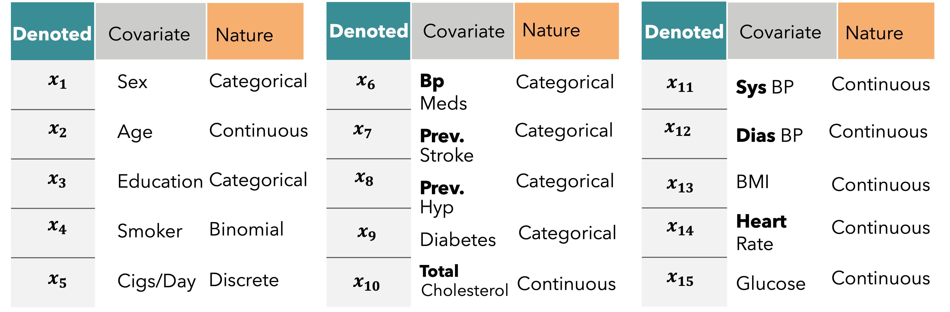
Briefly the Complete
DATASET
Notes:
Read Slide 32

Slide 33
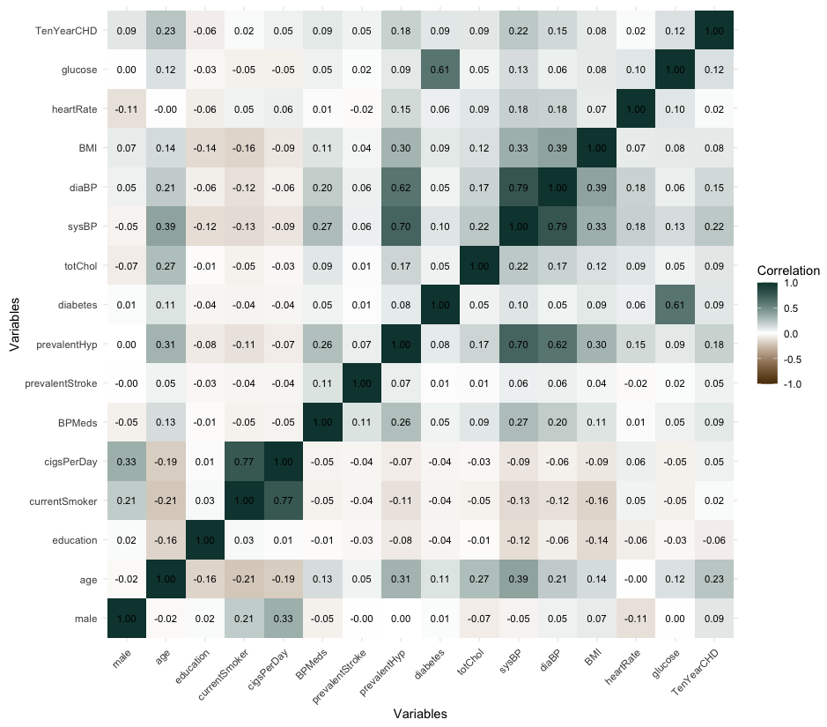

Wald’s Test for
03
02
01
Test Significance of
Checking for
Correlation
04
Significance
Fitting of
Parameters
01
Heatmap
Multicollinearity
Logistic Model
For testing the significance of the parameters, we’ll be using wald’s t test statistics Now suppose we want to test whether $x_{i}$ is significant or not. We’re to test
$H_{0}$ : Covariate $x_{i}$ is significant
$H_{1}$: Not Significant ; for, $i=1\left(1\right)k$
This is also similar to
$H_{0}$ : $β_{j}=0$ vs. $H_{1} :β_{1}≠0$
Test Statistic for testing the significance of the predictor variables then given by
$$t_{j}= \frac{β_{j} −E(β_{j})}{S.E(β_{j})}\sim N(0,1)$$
[Under H0] ; for, $i=1\left(1\right)k$ We’ll be rejecting the Null hypothesis and say that the$j^{th}$ covariateis not significant if
$$\left|τ_{J}\right|> τ_{\frac{α}{2}}$$
> data.frame(name,walds_t,significance) name walds_t significance 1 male 1.41443413 Significant 2 age 0.69723314 Significant 3 education -0.17188051 Significant 4 currentSmoker 0.27868337 Significant 5 cigsPerDay 0.17486239 Significant 6 BPMeds 0.31498194 Significant 7 prevalentStroke 0.77475590 Significant 8 prevalentHyp 0.64423554 Significant 9 diabetes 0.32965284 Significant 10 totChol 0.09111104 Significant 11 sysBP 0.21795368 Significant 12 diaBP -0.02802294 Significant 13 BMI 0.09083344 Significant 14 heartRate -0.04796687 Significant 15 glucose 0.12471948 Significant
Multicollinearity in linear models occurs when predictors are not independent, destabilizing coefficient interpretability. It's detected when the model’s R² is high (over 0.8), but few predictors are significant, or when pairwise correlations between predictors, assessed using Karl Pearson’s coefficient, exceed 0.8. Tools like VIF and correlation heatmaps refine these assessments by visualizing interdependencies. To ensure dataset integrity for linear modelling, a detailed quantitative follow-up analysis is essential.
Considering Backward Elimination as the selected stepwise procedure, the initial model encompasses all variables. Utilizing the glm() function in R, I’ve conducted logistic regression to analyze the association between the binary response variable indicating the presence of heart disease and the fifteen distinct independent predictors [Placed in earlier Slides]. The fitting process is outlined in the code as follows:
02
Methodologies
Used for
Logistic
Regression
03
03 .1
04
fullmodel = glm(TenYearCHD ~ ., data = training_data, family = binomial(link = "logit"))
Notes:
Now, let’s discuss the methodologies I've employed to analyze the data and fit the logistic regression model. To begin with, I divided the dataset into two parts: 80% for training and 20% for testing. All analyses and predictive modelling were conducted using the 80% portion, referred to as the training dataset. After fitting the model with this training data, I used the remaining 20%, known as the testing dataset, to evaluate the model's performance.
GO TO NEXT Slide

Slide 34
Wald’s Test for
03
02
01
Test Significance of
Checking for
Correlation
04
Significance
Fitting of
Parameters
01
Heatmap
Multicollinearity
Logistic Model
Methodologies
For testing the significance of the parameters, we’ll be using wald’s t test statistics Now suppose we want to test whether $x_{i}$ is significant or not. We’re to test
$H_{0}$ : Covariate $x_{i}$ is significant
$H_{1}$: Not Significant ; for, $i=1\left(1\right)k$
This is also similar to
$H_{0}$ : $β_{j}=0$ vs. $H_{1} :β_{1}≠0$
Test Statistic for testing the significance of the predictor variables then given by
$$t_{j}= \frac{β_{j} −E(β_{j})}{S.E(β_{j})}\sim N(0,1)$$
[Under H0] ; for, $i=1\left(1\right)k$ We’ll be rejecting the Null hypothesis and say that the$j^{th}$ covariateis not significant if
$$\left|τ_{J}\right|> τ_{\frac{α}{2}}$$
> data.frame(name,walds_t,significance) name walds_t significance 1 male 1.41443413 Significant 2 age 0.69723314 Significant 3 education -0.17188051 Significant 4 currentSmoker 0.27868337 Significant 5 cigsPerDay 0.17486239 Significant 6 BPMeds 0.31498194 Significant 7 prevalentStroke 0.77475590 Significant 8 prevalentHyp 0.64423554 Significant 9 diabetes 0.32965284 Significant 10 totChol 0.09111104 Significant 11 sysBP 0.21795368 Significant 12 diaBP -0.02802294 Significant 13 BMI 0.09083344 Significant 14 heartRate -0.04796687 Significant 15 glucose 0.12471948 Significant
Multicollinearity in linear models occurs when predictors are not independent, destabilizing coefficient interpretability. It's detected when the model’s R² is high (over 0.8), but few predictors are significant, or when pairwise correlations between predictors, assessed using Karl Pearson’s coefficient, exceed 0.8. Tools like VIF and correlation heatmaps refine these assessments by visualizing interdependencies. To ensure dataset integrity for linear modelling, a detailed quantitative follow-up analysis is essential.
Considering Backward Elimination as the selected stepwise procedure, the initial model encompasses all variables. Utilizing the glm() function in R, I’ve conducted logistic regression to analyze the association between the binary response variable indicating the presence of heart disease and the fifteen distinct independent predictors [Placed in earlier Slides]. The fitting process is outlined in the code as follows:
02
03
Logistic
Regression
03 .1
04
fullmodel = glm(TenYearCHD ~ ., data = training_data, family = binomial(link = "logit"))
Notes:
Read Slide 34

Slide 35
Wald’s Test for
03
02
Test Significance of
01
Checking for
Correlation
04
Significance
Fitting of
Parameters
01
Heatmap
Multicollinearity
Logistic Model
Methodologies
For testing the significance of the parameters, we’ll be using wald’s t test statistics Now suppose we want to test whether $x_{i}$ is significant or not. We’re to test
$H_{0}$ : Covariate $x_{i}$ is significant
$H_{1}$: Not Significant ; for, $i=1\left(1\right)k$
This is also similar to
$H_{0}$ : $β_{j}=0$ vs. $H_{1} :β_{1}≠0$
Test Statistic for testing the significance of the predictor variables then given by
$$t_{j}= \frac{β_{j} −E(β_{j})}{S.E(β_{j})}\sim N(0,1)$$
[Under H0] ; for, $i=1\left(1\right)k$ We’ll be rejecting the Null hypothesis and say that the$j^{th}$ covariateis not significant if
$$\left|τ_{J}\right|> τ_{\frac{α}{2}}$$
> data.frame(name,walds_t,significance) name walds_t significance 1 male 1.41443413 Significant 2 age 0.69723314 Significant 3 education -0.17188051 Significant 4 currentSmoker 0.27868337 Significant 5 cigsPerDay 0.17486239 Significant 6 BPMeds 0.31498194 Significant 7 prevalentStroke 0.77475590 Significant 8 prevalentHyp 0.64423554 Significant 9 diabetes 0.32965284 Significant 10 totChol 0.09111104 Significant 11 sysBP 0.21795368 Significant 12 diaBP -0.02802294 Significant 13 BMI 0.09083344 Significant 14 heartRate -0.04796687 Significant 15 glucose 0.12471948 Significant
Multicollinearity in linear models occurs when predictors are not independent, destabilizing coefficient interpretability. It's detected when the model’s R² is high (over 0.8), but few predictors are significant, or when pairwise correlations between predictors, assessed using Karl Pearson’s coefficient, exceed 0.8. Tools like VIF and correlation heatmaps refine these assessments by visualizing interdependencies. To ensure dataset integrity for linear modelling, a detailed quantitative follow-up analysis is essential.
Considering Backward Elimination as the selected stepwise procedure, the initial model encompasses all variables. Utilizing the glm() function in R, I’ve conducted logistic regression to analyze the association between the binary response variable indicating the presence of heart disease and the fifteen distinct independent predictors [Placed in earlier Slides]. The fitting process is outlined in the code as follows:
02
03
Logistic
Regression
03 .1
04
fullmodel = glm(TenYearCHD ~ ., data = training_data, family = binomial(link = "logit"))
Notes:
Here is the correlation heatmap, we can see there is no darker shade which means all the correlation coefficient between any two chosen set of predictors are quite low.

Slide 36

Wald’s Test for
03
02
01
Test Significance of
Checking for
Correlation
04
Significance
Fitting of
Parameters
Heatmap
01
Multicollinearity
Logistic Model
Methodologies
> data.frame(name,walds_t,significance) name walds_t significance 1 male 1.41443413 Significant 2 age 0.69723314 Significant 3 education -0.17188051 Significant 4 currentSmoker 0.27868337 Significant 5 cigsPerDay 0.17486239 Significant 6 BPMeds 0.31498194 Significant 7 prevalentStroke 0.77475590 Significant 8 prevalentHyp 0.64423554 Significant 9 diabetes 0.32965284 Significant 10 totChol 0.09111104 Significant 11 sysBP 0.21795368 Significant 12 diaBP -0.02802294 Significant 13 BMI 0.09083344 Significant 14 heartRate -0.04796687 Significant 15 glucose 0.12471948 Significant
For testing the significance of the parameters, we’ll be using wald’s t test statistics Now suppose we want to test whether $x_{i}$ is significant or not. We’re to test
$H_{0}$ : Covariate $x_{i}$ is significant
$H_{1}$: Not Significant ; for, $i=1\left(1\right)k$
This is also similar to
$H_{0}$ : $β_{j}=0$ vs. $H_{1} :β_{1}≠0$
Test Statistic for testing the significance of the predictor variables then given by
$$t_{j}= \frac{β_{j} −E(β_{j})}{S.E(β_{j})}\sim N(0,1)$$
[Under H0] ; for, $i=1\left(1\right)k$ We’ll be rejecting the Null hypothesis and say that the$j^{th}$ covariateis not significant if
$$\left|τ_{J}\right|> τ_{\frac{α}{2}}$$
Multicollinearity in linear models occurs when predictors are not independent, destabilizing coefficient interpretability. It's detected when the model’s R² is high (over 0.8), but few predictors are significant, or when pairwise correlations between predictors, assessed using Karl Pearson’s coefficient, exceed 0.8. Tools like VIF and correlation heatmaps refine these assessments by visualizing interdependencies. To ensure dataset integrity for linear modelling, a detailed quantitative follow-up analysis is essential.
Considering Backward Elimination as the selected stepwise procedure, the initial model encompasses all variables. Utilizing the glm() function in R, I’ve conducted logistic regression to analyze the association between the binary response variable indicating the presence of heart disease and the fifteen distinct independent predictors [Placed in earlier Slides]. The fitting process is outlined in the code as follows:
02
03
Logistic
Regression
03 .1
04
fullmodel = glm(TenYearCHD ~ ., data = training_data, family = binomial(link = "logit"))
Notes:
Read Slide 36
[ Here , j is the coefficient of the factor xj in the logit link.]

Slide 37
Wald’s Test for
03
02
01
Test Significance of
Checking for
Correlation
04
Fitting of
Significance
Parameters
01
Heatmap
Multicollinearity
Logistic Model
Methodologies
For testing the significance of the parameters, we’ll be using wald’s t test statistics Now suppose we want to test whether $x_{i}$ is significant or not. We’re to test
$H_{0}$ : Covariate $x_{i}$ is significant
$H_{1}$: Not Significant ; for, $i=1\left(1\right)k$
This is also similar to
$H_{0}$ : $β_{j}=0$ vs. $H_{1} :β_{1}≠0$
Test Statistic for testing the significance of the predictor variables then given by
$$t_{j}= \frac{β_{j} −E(β_{j})}{S.E(β_{j})}\sim N(0,1)$$
[Under H0] ; for, $i=1\left(1\right)k$ We’ll be rejecting the Null hypothesis and say that the$j^{th}$ covariateis not significant if
$$\left|τ_{J}\right|> τ_{\frac{α}{2}}$$
> data.frame(name,walds_t,significance) name walds_t significance 1 male 1.41443413 Significant 2 age 0.69723314 Significant 3 education -0.17188051 Significant 4 currentSmoker 0.27868337 Significant 5 cigsPerDay 0.17486239 Significant 6 BPMeds 0.31498194 Significant 7 prevalentStroke 0.77475590 Significant 8 prevalentHyp 0.64423554 Significant 9 diabetes 0.32965284 Significant 10 totChol 0.09111104 Significant 11 sysBP 0.21795368 Significant 12 diaBP -0.02802294 Significant 13 BMI 0.09083344 Significant 14 heartRate -0.04796687 Significant 15 glucose 0.12471948 Significant
Multicollinearity in linear models occurs when predictors are not independent, destabilizing coefficient interpretability. It's detected when the model’s R² is high (over 0.8), but few predictors are significant, or when pairwise correlations between predictors, assessed using Karl Pearson’s coefficient, exceed 0.8. Tools like VIF and correlation heatmaps refine these assessments by visualizing interdependencies. To ensure dataset integrity for linear modelling, a detailed quantitative follow-up analysis is essential.
Considering Backward Elimination as the selected stepwise procedure, the initial model encompasses all variables. Utilizing the glm() function in R, I’ve conducted logistic regression to analyze the association between the binary response variable indicating the presence of heart disease and the fifteen distinct independent predictors [Placed in earlier Slides]. The fitting process is outlined in the code as follows:
02
03
Logistic
Regression
04
03 .1
fullmodel = glm(TenYearCHD ~ ., data = training_data, family = binomial(link = "logit"))
Notes:
This is the outcome of Wald's test statistics.

Slide 38
Wald’s Test for
03
02
01
Test Significance of
Checking for
Correlation
04
Significance
Fitting of
Parameters
01
Heatmap
Multicollinearity
Logistic Model
Methodologies
For testing the significance of the parameters, we’ll be using wald’s t test statistics Now suppose we want to test whether $x_{i}$ is significant or not. We’re to test
$H_{0}$ : Covariate $x_{i}$ is significant
$H_{1}$: Not Significant ; for, $i=1\left(1\right)k$
This is also similar to
$H_{0}$ : $β_{j}=0$ vs. $H_{1} :β_{1}≠0$
Test Statistic for testing the significance of the predictor variables then given by
$$t_{j}= \frac{β_{j} −E(β_{j})}{S.E(β_{j})}\sim N(0,1)$$
[Under H0] ; for, $i=1\left(1\right)k$ We’ll be rejecting the Null hypothesis and say that the$j^{th}$ covariateis not significant if
$$\left|τ_{J}\right|> τ_{\frac{α}{2}}$$
> data.frame(name,walds_t,significance) name walds_t significance 1 male 1.41443413 Significant 2 age 0.69723314 Significant 3 education -0.17188051 Significant 4 currentSmoker 0.27868337 Significant 5 cigsPerDay 0.17486239 Significant 6 BPMeds 0.31498194 Significant 7 prevalentStroke 0.77475590 Significant 8 prevalentHyp 0.64423554 Significant 9 diabetes 0.32965284 Significant 10 totChol 0.09111104 Significant 11 sysBP 0.21795368 Significant 12 diaBP -0.02802294 Significant 13 BMI 0.09083344 Significant 14 heartRate -0.04796687 Significant 15 glucose 0.12471948 Significant
Multicollinearity in linear models occurs when predictors are not independent, destabilizing coefficient interpretability. It's detected when the model’s R² is high (over 0.8), but few predictors are significant, or when pairwise correlations between predictors, assessed using Karl Pearson’s coefficient, exceed 0.8. Tools like VIF and correlation heatmaps refine these assessments by visualizing interdependencies. To ensure dataset integrity for linear modelling, a detailed quantitative follow-up analysis is essential.
Considering Backward Elimination as the selected stepwise procedure, the initial model encompasses all variables. Utilizing the glm() function in R, I’ve conducted logistic regression to analyze the association between the binary response variable indicating the presence of heart disease and the fifteen distinct independent predictors [Placed in earlier Slides]. The fitting process is outlined in the code as follows:
02
03
Logistic
Regression
03 .1
04
fullmodel = glm(TenYearCHD ~ ., data = training_data, family = binomial(link = "logit"))
Notes:
Read Slide 38

Slide 39
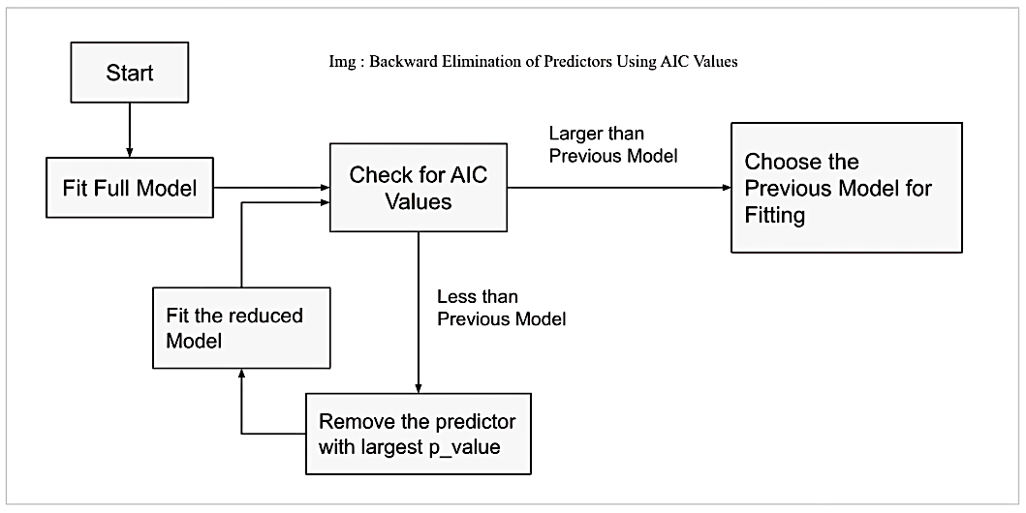
Backward Elimination
Method
After fitting the full regression model , we go for Backward Elimination method.
Backward elimination is a method used to identify the independent variables that contribute to the best regression model. It is a component of stepwise regression, a feature selection technique employed in ML model development. Backward elimination is a systematic process that begins with a full set of features ( i.e full logistic regression Model ) and iteratively removes variables until the model's performance is optimized. In ML, there are several other approaches as well.
Notes:
After fitting the full model , we’ll be using the Backward elimination procedure.
Read Slide 39

Slide 40
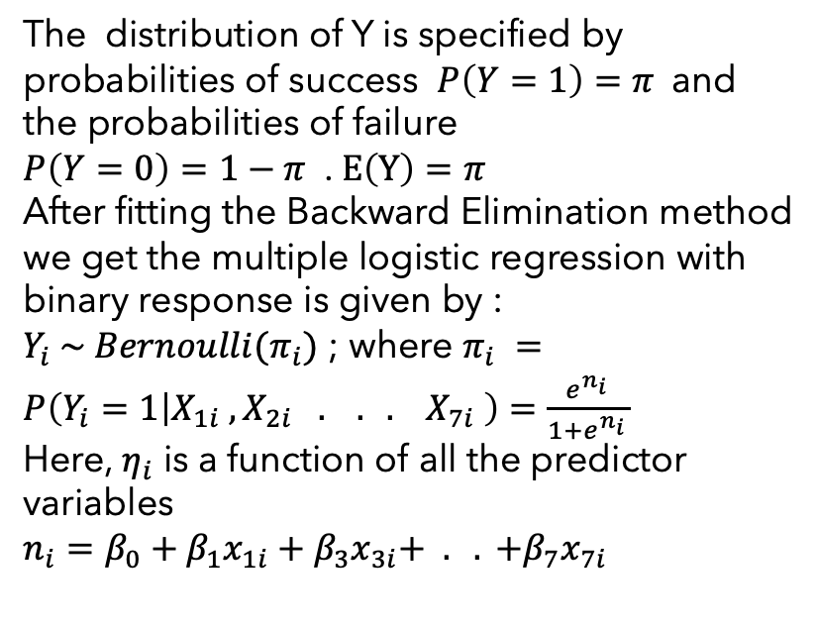
Best Fitted
Model
Call: glm(formula = TenYearCHD ~ ., family = binomial(link = "logit"), data = reduced_data_8) Coefficients: Estimate Std. Error z value Pr(>|z|) (Intercept) -8.732172 0.602685 -14.489 < 2e-16 *** male 0.502872 0.122016 4.121 3.77e-05 *** age 0.062626 0.007304 8.574 < 2e-16 *** cigsPerDay 0.017669 0.004796 3.684 0.000229 *** prevalentHyp 0.268576 0.153346 1.751 0.079871 . totChol 0.003190 0.001271 2.511 0.012046 * sysBP 0.013961 0.003193 4.372 1.23e-05 *** glucose 0.007262 0.001912 3.798 0.000146 *** --- Signif. codes: 0 '***' 0.001 '**' 0.01 '*' 0.05 '.' 0.1 ' ' 1 (Dispersion parameter for binomial family taken to be 1) Null deviance: 2379 on 2742 degrees of freedom Residual deviance: 2112 on 2735 degrees of freedom AIC: 2128 Number of Fisher Scoring iterations: 5
The distribution of Y is specified by probabilities of success $P\left(Y=1\right)=π$and the probabilities of failure
$P\left(Y=0\right)=1−π$ . $E\left(Y\right)=π$
After fitting the Backward Elimination method
we get the multiple logistic regression with binary response is given by :
$Y_{i} \sim Bernoulli(π_{i})$ ; where $π_{i} =P\left(Y_{i}=1 | X_{1i} , X_{2i} . . . X_{7i} \right)=\frac{e^{n_{i }}}{1+e^{n_{i }}}$
Here, $η_{i}$ is a function of all the predictor variables
$n_{i}=β_{0}+β_{1}x_{1i}+β_{3}x_{3i}+ . . +β_{7}x_{7i}$
Notes:
Read Slide 40

Slide 41
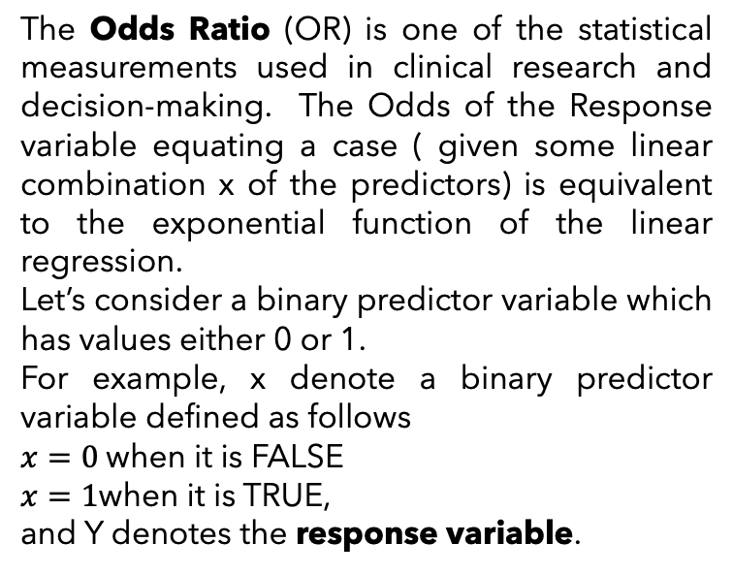
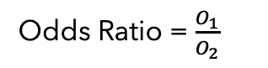

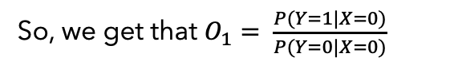
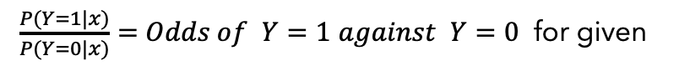
Odds
Ratio
In short, OR(Odds Ratio)
Then
$\frac{P(Y=1|x)}{P(Y=0|x)}=$ $Odds of$ $Y=1$ $against$ $Y=0$ for given
The Odds Ratio (OR) is one of the statistical measurements used in clinical research and decision-making. The Odds of the Response variable equating a case ( given some linear combination x of the predictors) is equivalent to the exponential function of the linear regression.
Let’s consider a binary predictor variable which has values either 0 or 1.
For example, x denote a binary predictor variable defined as follows
$x=0$when it is FALSE
$x=1$when it is TRUE,
and Y denotes the response variable.
Given value of x
So, we get that $O_{1}= \frac{P(Y=1|X=0)}{P(Y=0|X=0)}$
And $O_{2}= \frac{P(Y=1|X=1)}{P(Y=0|X=1)}$
Odds Ratio = $\frac{O_{1}}{O_{2}}$
> Odds_Ratio exp(estimates) male 1.653463 age 1.064628 cigsPerDay 1.017826 prevalentHyp 1.308100 totChol 1.003195 sysBP 1.014059 glucose 1.007288 >
Notes:
Read Slide 41

Slide 42

Glucose Level
1.007288
With each unit increase in glucose level, the odds of being diagnosed with heart disease increase by approximately 0.73%.
Sys Blood Pressure
1.014059
For each unit increase in systolic blood pressure, the odds of being diagnosed with heart disease increase by approximately 1.41%.
Cholesterol
1.003195
With each unit increase in total cholesterol level, the odds of being diagnosed with heart disease increase by approximately 0.32%
Prevalent Hypersensitive
1.308100
Individuals with prevalent hypertension have approximately 30.81% higher odds of being diagnosed with heart disease compared to those without prevalent hypertension.
Cigarettes Per Day
1.017826
For each additional cigarette smoked per day, the odds of getting diagnosed with heart disease increase by approximately 1.8%
Age
1.064628
The coefficient for age says that, holding all others constant, we will see a 6.5% increase in the odds of getting diagnosed with CDH for a one year increase in age since exp(0.062625) = 1.064628.
Demographic
Factor
Interpretation of
Odds Ratio
Male
1.653463
In this model, with all other factors controlled, males [male=1] have a 1.653 times higher odds of being diagnosed with heart disease compared to females [male=0]. This suggests a 65.34% greater likelihood of heart disease among males relative to females
No.of
Cigs
HYP
Total
Chols.
SYS
Bp.
Glucose
Notes:
Read Slide 42

Slide 43
Glucose Level
1.007288
With each unit increase in glucose level, the odds of being diagnosed with heart disease increase by approximately 0.73%.
Sys Blood Pressure
1.014059
For each unit increase in systolic blood pressure, the odds of being diagnosed with heart disease increase by approximately 1.41%.
Cholesterol
1.003195
With each unit increase in total cholesterol level, the odds of being diagnosed with heart disease increase by approximately 0.32%
Prevalent Hypersensitive
1.308100
Individuals with prevalent hypertension have approximately 30.81% higher odds of being diagnosed with heart disease compared to those without prevalent hypertension.
Cigarettes Per Day
1.017826
For each additional cigarette smoked per day, the odds of getting diagnosed with heart disease increase by approximately 1.8%
Demographic
Factor
Interpretation of
Odds Ratio
Age
1.064628
The coefficient for age says that, holding all others constant, we will see a 6.5% increase in the odds of getting diagnosed with CDH for a one year increase in age since exp(0.062625) = 1.064628.
No.of
Male
1.653463
Cigs
In this model, with all other factors controlled, males [male=1] have a 1.653 times higher odds of being diagnosed with heart disease compared to females [male=0]. This suggests a 65.34% greater likelihood of heart disease among males relative to females
HYP
Total
Chols.
SYS
Bp.
Glucose
Notes:
Read Slide 43

Slide 44
Glucose Level
1.007288
With each unit increase in glucose level, the odds of being diagnosed with heart disease increase by approximately 0.73%.
Sys Blood Pressure
1.014059
For each unit increase in systolic blood pressure, the odds of being diagnosed with heart disease increase by approximately 1.41%.
Cholesterol
1.003195
With each unit increase in total cholesterol level, the odds of being diagnosed with heart disease increase by approximately 0.32%
Prevalent Hypersensitive
1.308100
Individuals with prevalent hypertension have approximately 30.81% higher odds of being diagnosed with heart disease compared to those without prevalent hypertension.
Behavioral
Factor
Interpretation of
Odds Ratio
Cigarettes Per Day
1.017826
For each additional cigarette smoked per day, the odds of getting diagnosed with heart disease increase by approximately 1.8%
No.of
Cigs
Age
1.064628
HYP
The coefficient for age says that, holding all others constant, we will see a 6.5% increase in the odds of getting diagnosed with CDH for a one year increase in age since exp(0.062625) = 1.064628.
Total
Chols.
Male
1.653463
In this model, with all other factors controlled, males [male=1] have a 1.653 times higher odds of being diagnosed with heart disease compared to females [male=0]. This suggests a 65.34% greater likelihood of heart disease among males relative to females
SYS
Bp.
Glucose
Notes:
Read Slide 44

Slide 45
Glucose Level
1.007288
With each unit increase in glucose level, the odds of being diagnosed with heart disease increase by approximately 0.73%.
Sys Blood Pressure
1.014059
For each unit increase in systolic blood pressure, the odds of being diagnosed with heart disease increase by approximately 1.41%.
Cholesterol
1.003195
With each unit increase in total cholesterol level, the odds of being diagnosed with heart disease increase by approximately 0.32%
No.of
Cigs
Medical
History
Interpretation of
Odds Ratio
Prevalent Hypersensitive
1.308100
Individuals with prevalent hypertension have approximately 30.81% higher odds of being diagnosed with heart disease compared to those without prevalent hypertension.
HYP
Total
Cigarettes Per Day
Chols.
1.017826
For each additional cigarette smoked per day, the odds of getting diagnosed with heart disease increase by approximately 1.8%
SYS
Bp.
Age
1.064628
The coefficient for age says that, holding all others constant, we will see a 6.5% increase in the odds of getting diagnosed with CDH for a one year increase in age since exp(0.062625) = 1.064628.
Glucose
Male
1.653463
In this model, with all other factors controlled, males [male=1] have a 1.653 times higher odds of being diagnosed with heart disease compared to females [male=0]. This suggests a 65.34% greater likelihood of heart disease among males relative to females
Notes:
Read Slide 45

Slide 46
Glucose Level
1.007288
With each unit increase in glucose level, the odds of being diagnosed with heart disease increase by approximately 0.73%.
No.of
Cigs
Sys Blood Pressure
1.014059
For each unit increase in systolic blood pressure, the odds of being diagnosed with heart disease increase by approximately 1.41%.
HYP
Medical
History
Interpretation of
Odds Ratio
Cholesterol
1.003195
With each unit increase in total cholesterol level, the odds of being diagnosed with heart disease increase by approximately 0.32%
Total
Chols.
Prevalent Hypersensitive
1.308100
SYS
Individuals with prevalent hypertension have approximately 30.81% higher odds of being diagnosed with heart disease compared to those without prevalent hypertension.
Bp.
Glucose
Cigarettes Per Day
1.017826
For each additional cigarette smoked per day, the odds of getting diagnosed with heart disease increase by approximately 1.8%
Age
1.064628
The coefficient for age says that, holding all others constant, we will see a 6.5% increase in the odds of getting diagnosed with CDH for a one year increase in age since exp(0.062625) = 1.064628.
Male
1.653463
In this model, with all other factors controlled, males [male=1] have a 1.653 times higher odds of being diagnosed with heart disease compared to females [male=0]. This suggests a 65.34% greater likelihood of heart disease among males relative to females
Notes:
Read Slide 46

Slide 47
No.of
Cigs
HYP
Glucose Level
1.007288
With each unit increase in glucose level, the odds of being diagnosed with heart disease increase by approximately 0.73%.
Total
Chols.
Medical
History
Interpretation of
Odds Ratio
Sys Blood Pressure
1.014059
For each unit increase in systolic blood pressure, the odds of being diagnosed with heart disease increase by approximately 1.41%.
SYS
Bp.
Cholesterol
1.003195
Glucose
With each unit increase in total cholesterol level, the odds of being diagnosed with heart disease increase by approximately 0.32%
Prevalent Hypersensitive
1.308100
Individuals with prevalent hypertension have approximately 30.81% higher odds of being diagnosed with heart disease compared to those without prevalent hypertension.
Cigarettes Per Day
1.017826
For each additional cigarette smoked per day, the odds of getting diagnosed with heart disease increase by approximately 1.8%
Age
1.064628
The coefficient for age says that, holding all others constant, we will see a 6.5% increase in the odds of getting diagnosed with CDH for a one year increase in age since exp(0.062625) = 1.064628.
Male
1.653463
In this model, with all other factors controlled, males [male=1] have a 1.653 times higher odds of being diagnosed with heart disease compared to females [male=0]. This suggests a 65.34% greater likelihood of heart disease among males relative to females
Notes:
Read Slide 47

Slide 48
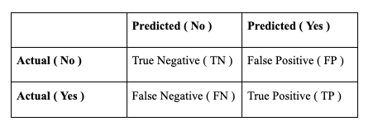
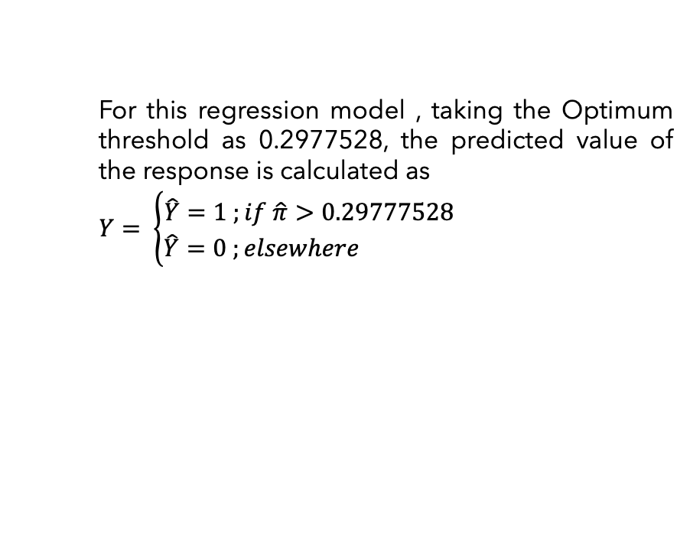
No.of
Cigs
HYP
Total
Chols.
SYS
Bp.
Medical
History
Interpretation of
Odds Ratio
Glucose Level
1.007288
With each unit increase in glucose level, the odds of being diagnosed with heart disease increase by approximately 0.73%.
Glucose
Classification
The fitted model is considered as an accurate representation of the data set if the true positives and negatives are maximized, and the false positives and false negatives are maximized. Accuracy can be calculated using the confusion matrix.
Statistics
Sys Blood Pressure
Before we dive into the Classification Probabilities, let's arm ourselves with some key terms to navigate the terrain more smoothly..
1.014059
For each unit increase in systolic blood pressure, the odds of being diagnosed with heart disease increase by approximately 1.41%.
For this regression model , taking the Optimum threshold as 0.2977528, the predicted value of the response is calculated as
$Y= \left\{\begin{aligned}\hat{Y}=1 ;if \hat{π}>0.29777528 \\ \hat{Y}=0 ;elsewhere \end{aligned}\right.$
True Positive (TP)
If the predicted value and the actual value are both positive.
True Negative (TP)
If the predicted value and the actual value are both negative.
False Positive (FP)
If the predicted value is positive, but the actual value is negative. (Type I Error )
False Negative (FN) :
If the predicted value is negative, but the actual value is positive . (Type II Error )
Cholesterol
1.003195
With each unit increase in total cholesterol level, the odds of being diagnosed with heart disease increase by approximately 0.32%
Prevalent Hypersensitive
1.308100
Individuals with prevalent hypertension have approximately 30.81% higher odds of being diagnosed with heart disease compared to those without prevalent hypertension.
Cigarettes Per Day
1.017826
For each additional cigarette smoked per day, the odds of getting diagnosed with heart disease increase by approximately 1.8%
Age
1.064628
The coefficient for age says that, holding all others constant, we will see a 6.5% increase in the odds of getting diagnosed with CDH for a one year increase in age since exp(0.062625) = 1.064628.
Male
1.653463
In this model, with all other factors controlled, males [male=1] have a 1.653 times higher odds of being diagnosed with heart disease compared to females [male=0]. This suggests a 65.34% greater likelihood of heart disease among males relative to females
Notes:
Read Slide 48

Slide 49
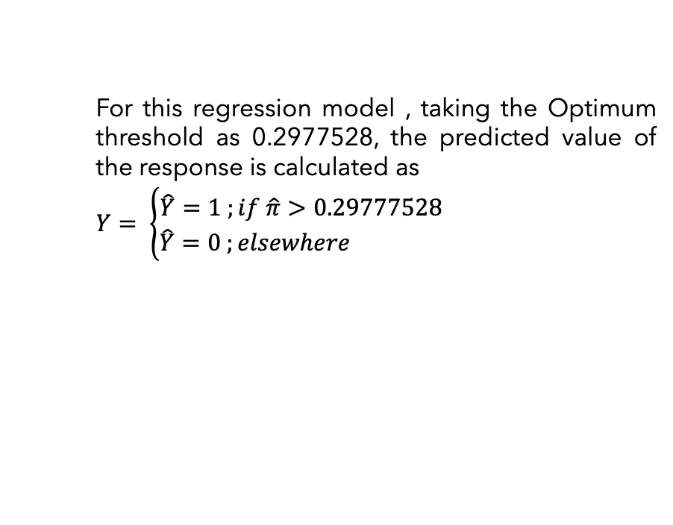
No.of
Cigs
HYP
Total
Chols.
SYS
Bp.
Glucose
Classification
The fitted model is considered as an accurate representation of the data set if the true positives and negatives are maximized, and the false positives and false negatives are maximized. Accuracy can be calculated using the confusion matrix.
Statistics
Before we dive into the Classification Probabilities, let's arm ourselves with some key terms to navigate the terrain more smoothly..
For this regression model , taking the Optimum threshold as 0.2977528, the predicted value of the response is calculated as
$Y= \left\{\begin{aligned}\hat{Y}=1 ;if \hat{π}>0.29777528 \\ \hat{Y}=0 ;elsewhere \end{aligned}\right.$
True Positive (TP)
If the predicted value and the actual value are both positive.
True Negative (TP)
If the predicted value and the actual value are both negative.
False Positive (FP)
If the predicted value is positive, but the actual value is negative. (Type I Error )
False Negative (FN) :
If the predicted value is negative, but the actual value is positive . (Type II Error )
Notes:
After successfully fitting the optimal regression model, let's now examine some key classification statistics.
Read Slide 49
The optimum threshold is obtained at that value of predicted probabilities for which the product of True Positive Rate (TPR) and (1 - False Positive Rate (FPR)) is maximum, not minimum. This threshold maximises the discrimination power of the model between the positive and negative classes.

Slide 50
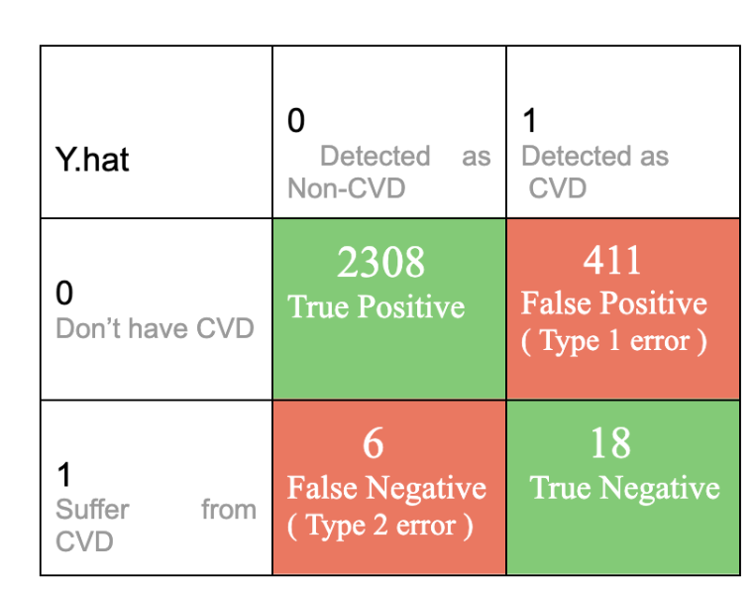
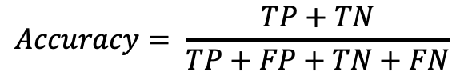
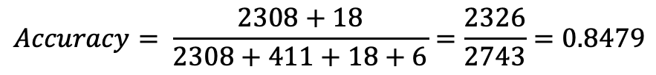
Classification
Statistics
Misclassification Rate
Accuracy Accuracy provides a detailed summary of the information conveyed by the confusion matrix. It is computed by dividing the sum of true positives and true negatives by the total number of observations, offering a measure of the fitted model's overall correctness. It is measures as follows .
Confusion Matrix of the Chosen Model
Sensitivity
Accuracy
Specificity
$$Accuracy= \frac{TP+TN}{TP+FP+TN+FN}$$
For this chosen logistic regression model ,
Conclusion
Precision
This model can classify and predict the Cardiovascular Disease with 84.79 % Accuracy
$$Accuracy= \frac{2308+18}{2308+411+18+6}=\frac{2326}{2743}=0.8479$$
Notes:
Read Slide 50

Slide 51
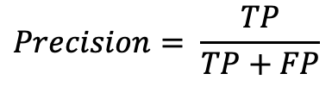
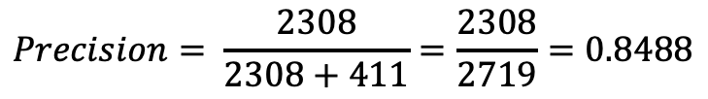
Classification
Statistics
Misclassification Rate
Precision Precision denotes the accuracy level of a model's positive predictions. It quantifies the proportion of true positive predictions relative to the overall number of positive predictions generated by the model.
Confusion Matrix of the Chosen Model
Sensitivity
Accuracy
$$Precision= \frac{TP}{TP+FP}$$
Specificity
For this chosen logistic regression model ,
Conclusion
Approximately 89.35% of the positive predictions made by the model are correct. In other words, when the model predicts a positive outcome, it is accurate about 84.88% of the time.
Precision
$$Precision= \frac{2308}{2308+411}=\frac{2308}{2719}=0.8488$$
Notes:
Read Slide 51

Slide 52
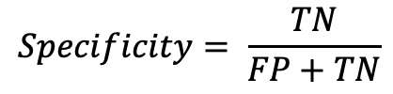
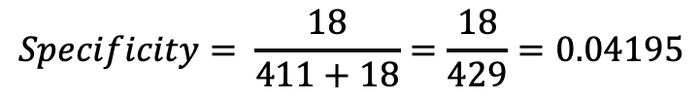
Classification
Statistics
Misclassification Rate
Specificity Specificity, also referred to as the True Negative Rate, gauges the model's capacity to accurately identify negative instances. It is determined by dividing the number of true negative predictions by the total count of actual negative instances.
Confusion Matrix of the Chosen Model
Sensitivity
Accuracy
$$Specificity= \frac{TN}{FP+TN}$$
Specificity
For this chosen logistic regression model ,
Conclusion
it means that approximately 4.195% of the true negative cases are correctly identified by the model.
Precision
$$Specificity= \frac{18}{411+18}=\frac{18}{429}=0.04195$$
Notes:
Read Slide 52

Slide 53
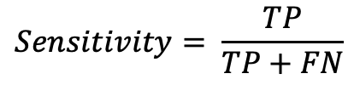
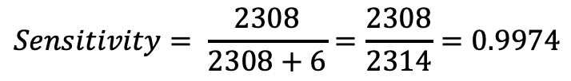
Classification
Statistics
Misclassification Rate
Sensitivity Similarly termed as the True Positive Rate or Recall, sensitivity assesses the model's ability to correctly identify positive instances. It is computed by dividing the number of true positive predictions by the total count of actual positive instances
Confusion Matrix of the Chosen Model
Sensitivity
Accuracy
$$Sensitivity= \frac{TP}{TP+FN}$$
Specificity
For this chosen logistic regression model ,
Conclusion
It means that approximately 99.74% of the true positive cases are correctly identified by the model.
Precision
$$Sensitivity= \frac{2308}{2308+6}=\frac{2308}{2314}=0.9974$$
Notes:
Read Slide 53

Slide 54
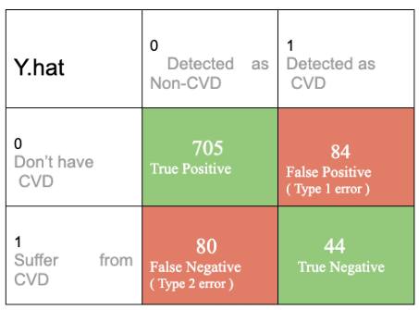
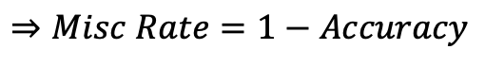
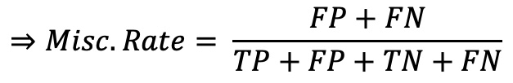
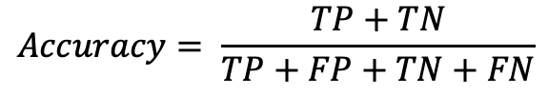
Classification
Statistics
Misclassification Rate
Misclassification Rate The Misclassification Rate in Logistic Regression is the proportion of wrongly classified observations, indicating how accurately the model predicts outcomes.
Confusion Matrix of the Chosen Model
Sensitivity
Accuracy
$$Accuracy= \frac{TP+TN}{TP+FP+TN+FN}$$
$$⇒Misc Rate=1−Accuracy$$
Specificity
$$⇒Misc. Rate= \frac{FP+FN}{TP+FP+TN+FN}$$
Conclusion
Precision
For this chosen logistic regression model ,
It means that approximately 15.21% of the observations in the dataset are misclassified by the model.
$Misc rate=1−Accuracy=1−$ $0.8479$ = 0.1521
Notes:
Read Slide 54

Slide 55
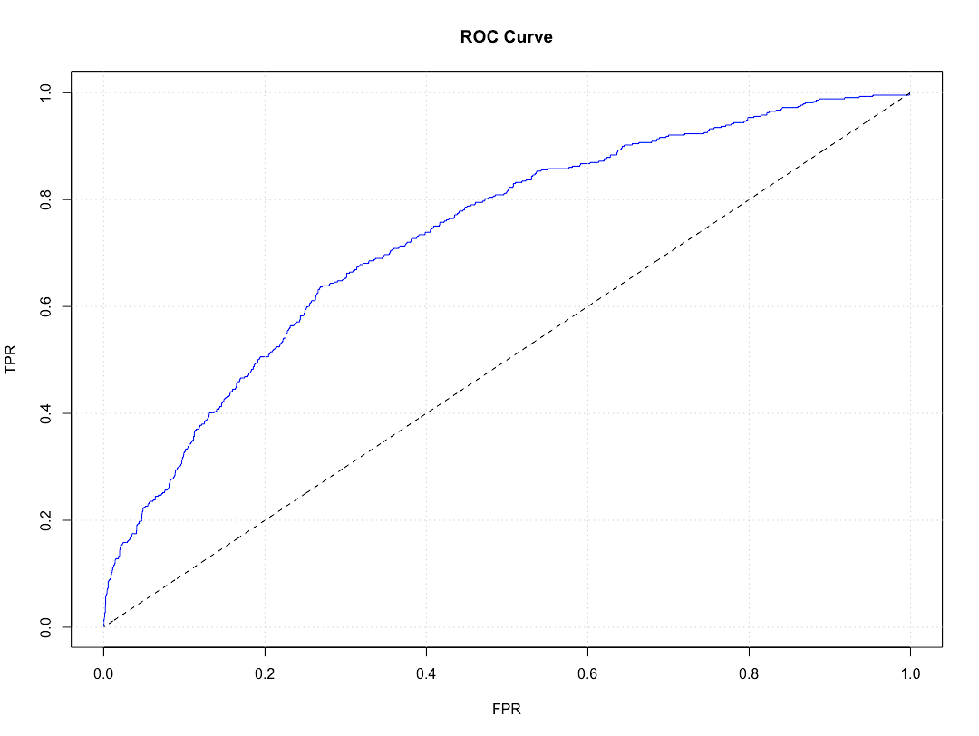
Receiver Operator
Characteristic Curve
The ROC curve serves as a vital tool in assessing the predictive capability of a model by visualizing the trade-off between its True Positive Rate (TPR) and False Positive Rate (FPR). A higher area under the ROC curve indicates superior discriminatory power of the model, with values closer to 1 suggesting better performance. In this case, with an area under the ROC curve of 0.7335 for the logistic regression model, it suggests that the model exhibits reasonably good discriminatory ability in distinguishing between positive and negative cases. This value signifies that the model performs significantly better than random guessing and can effectively classify instances into their respective classes, albeit with room for potential improvement.
Notes:
Read Slide 54

Slide 56
Testing the Model
In Test Data
fitted_prob_test = predict(Selected_Model, newdata = testing_data, type = "response") Y.hat_test = ifelse(fitted_prob_test > optimal_thresold_for_test_data, 1, 0) confusion_matrix_test_data = table(Y.hat_test, testing_data$TenYearCHD) confusion_matrix_test_data accuracy_test = sum(diag(confusion_matrix_test_data)) / sum(confusion_matrix_test_data) round(accuracy_test, 4) roc_curve = roc(testing_data$TenYearCHD, fitted_prob_test) auc(roc_curve)
Test data ; at the beginning I’ve split the dataset into 8:2 parts so that I can use the the training data for training purpose and test data for testing the model.
Accuracy : 82.03%
Area Under the Curve :
0.7465
Notes:
Read Slide 56

Slide 57
Testing the Model
In Test Data
fitted_prob_test = predict(Selected_Model, newdata = testing_data, type = "response") Y.hat_test = ifelse(fitted_prob_test > optimal_thresold_for_test_data, 1, 0) confusion_matrix_test_data = table(Y.hat_test, testing_data$TenYearCHD) confusion_matrix_test_data accuracy_test = sum(diag(confusion_matrix_test_data)) / sum(confusion_matrix_test_data) round(accuracy_test, 4) roc_curve = roc(testing_data$TenYearCHD, fitted_prob_test) auc(roc_curve)
Test data ; at the beginning I’ve split the dataset into 8:2 parts so that I can use the the training data for training purpose and test data for testing the model.
Accuracy : 82.03%
Area Under the Curve :
0.7465
Notes:
Read Slide 57

Slide 58
Final
Prevalent Hypertension:
Individuals with prevalent hypertension have a 30.81% higher odds of heart disease diagnosis, highlighting the importance of managing blood pressure.
Total Cholesterol Level:
A one-unit increase in total cholesterol level corresponds to a 0.32% rise in the odds of heart disease diagnosis, underscoring the significance of lipid management.
Systolic Blood Pressure:
Each unit increase in systolic blood pressure is associated with a 1.41% increase in the odds of heart disease diagnosis, emphasizing the importance of blood pressure control.
Glucose Level:
With each unit increase in glucose level, the odds of heart disease diagnosis increase by approximately 0.73%, indicating the relevance of glycemic control.
These findings collectively highlight the multifactorial nature of heart disease risk and underscore the importance of addressing various modifiable risk factors in preventive strategies and clinical management.
Conclusion
In conclusion, our analysis reveals several significant predictors of heart disease diagnosis.
Gender:
Males exhibit a 65.34% higher likelihood of heart disease diagnosis compared to females, suggesting a notable gender-based disparity.
Age:
Each one-year increase in age corresponds to a 6.5% rise in the odds of heart disease diagnosis, indicating age as a significant risk factor.
Cigarette Consumption:
The odds of heart disease diagnosis increase by approximately 1.8% with each additional cigarette smoked per day, emphasizing the detrimental effects of smoking.
Notes:
Read Slide 58

Slide 59
Know
How
I’m very much thankful to you for giving your valuable knowledge and knowhow to fulfil this dissertation topic.
Notes:
Read Slide 59

Slide 60
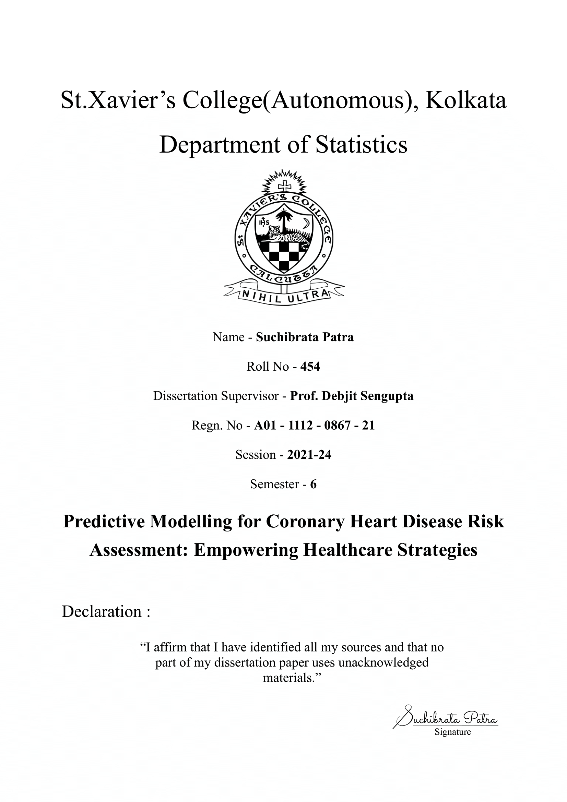
Notes:
Stop

Slide 61
Backup
Slides

Slide 62
Scope and Objective
A
B
C
D
Investigate how lifestyle choices impact heart health and explore ways to reduce the risk of cardiovascular disease (CVD).
Evaluate the imp. of
early detection in preventing severe outcomes related to CVD.
Develop and test statistical models to identify individuals at high risk of developing CVD, aiding in timely intervention and prevention.
Provide actionable insights for healthcare prof. and policymakers to make strategies for reducing the global burden of CVD.
Main Slide

Slide 63
GETTING TO KNOW THE
DATASET
Glucose
Heart
Rate
BMI
DIAS BP
SYS BP
Chol.
Diabetes
HYP
STROKE
BP
No. of
No
Origin
Glucose
Heart
Rate
BMI
DIAS BP
Cigs
No of Datapoints
Origin Of the Dataset
No of Datapoints
CHD - 10 Year Risk
Sex
Age
Education
Current Smoker
Cigs. Per Day
BP Meds
Prevalent Stroke
Prevalent Hypersensitivity
Diabetes
Total Cholesterol
Sys BP
Dia BP
BMI
Heart Rate
Glucose
In the Dataset, there are in total 3,657 data points available encompassing various demographic, behavioural, and medical risk factors.
This Cardiovascular Disease Dataset Dataset Was collected from the UCI Machine Learning Library
In the Dataset, there are in total 3,657 data points available encompassing various demographic, behavioural, and medical risk factors.
Binary Variables
Binary Variable indicating the presence (1) or absence(0) of CHD risk.
Categorical ( Nominal )
0 = Female , 1 = male
Continuous
Age in years
Categorical ( Nominal )
Denotes the Education Level of the individual.
1 : Pre-College Level
2 : Undergrad Level
3 : Postgrad Level
Categorical ( Nominal )
0 = Don’t Smoke , 1 = Smoke
Categorical ( Nominal )
0 = Don’t Smoke , 1 = Smoke
Categorical ( Nominal )
Specifies if the individual was using medication for blood pressure management..[ 0 = Not Diabetic , 1 = Diabetic ]
Categorical ( Nominal )
Identifies whether the patient has previously experienced a stroke. [ 0 = Haven’t , 1 = Have experienced ]
Categorical ( Nominal )
Indicates whether the patient is hypertensive [ 0 =Patient isn’t Hypersensitive,1=Patient is Hypersensitive ]
Categorical ( Nominal )
Identifies whether the patient has diabetes. [0 = Patient isn’t Diabetes , 1 = Patient is Diabetic ]
Continuous
Represents the total blood cholesterol level.
Continuous
Represents the systolic blood pressure level.
Continuous
Represents the Diastolic blood pressure level
Continuous
Represents the individual’s Body Mass Index
Continuous
Represents the heart rate treated as continuous due to the large number of possible values.
Continuous
Represents the heart rate treated as continuous due to the large number of possible values.

Slide 64
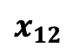
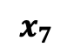
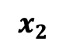
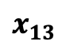
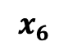
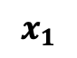
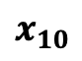
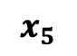
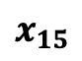
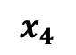
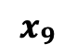
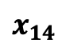
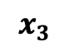
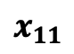
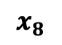
Briefly the Complete
DATASET
Denoted
Covariate
Nature
Denoted
Covariate
Nature
Denoted
Covariate
Nature
$$x_{1}$$
Sex
Categorical
$$x_{6}$$
Bp Meds
Categorical
$$x_{11}$$
Sys BP
Continuous
$$x_{2}$$
Age
Continuous
$$x_{7}$$
Prev.
Categorical
$$x_{12}$$
Dias BP
Continuous
Stroke
$$x_{3}$$
Education
Categorical
$$x_{8}$$
Categorical
$$x_{13}$$
BMI
Continuous
Prev.
Hyp
$$x_{4}$$
Smoker
Binomial
$$x_{9}$$
$$x_{14}$$
Heart Rate
Continuous
Diabetes
Categorical
$$x_{5}$$
Cigs/Day
Discrete
$$x_{10}$$
Total
$$x_{15}$$
Glucose
Continuous
Cholesterol
Continuous

